Slide 1









Confusing my viewpoint with his: Altered self-other distinction in ASPD
BIGOT Alix
In collaboration with:
Notes:
Hello my name is Alix, today i am going to talk about antisocial perso disorder, and the presence of an altered self-other distinction ability in this population

Slide 2
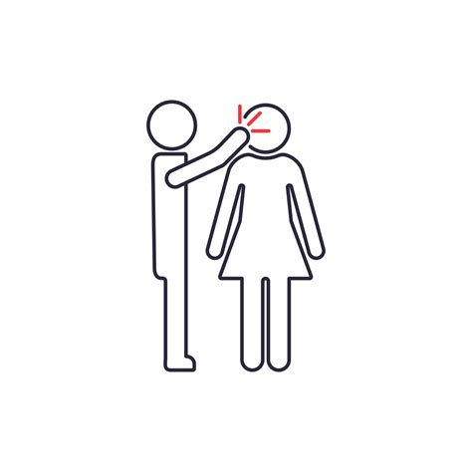

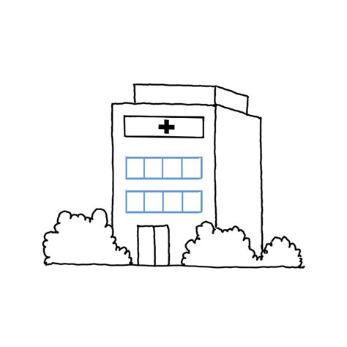
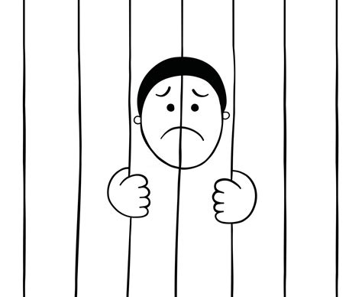
Introduction: Antisocial personality disorder (ASPD)
Impulsivity, agressivity
Lack of guilt, remorse and empathy
Deception and exploitation of others
Repeated harm to others
Egocentrism ?
Notes:
So first, i’ll start by defining what is antisocial personality disorder
This specific personality disorder is characterized by a low threshold for impulsivity and agressivity, that manifest by emotional outburst and violence toward others
The individuals with such diagnosis often demonstrate a lack of guilt, remorse and, more generally, a lack of empathy or consideration for others, as they tend to deceive and exploit for their own endeavors.
So overall, individuals with ASPD are often blamed for their high level of egocentrism, that put them at high risk for incarceration, hospitalization, domestic violence. But what is really egocentrism ?
→ Axé sur egocentrisme

Slide 3
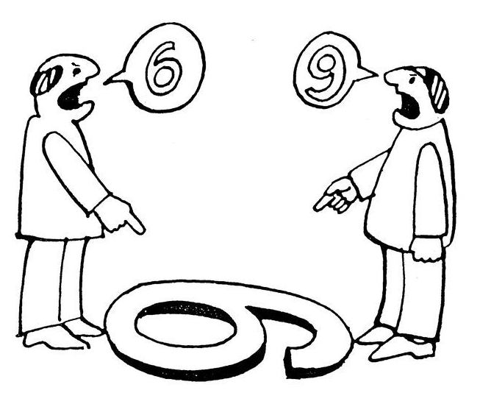


Introduction: Social cognition in ASPD
Egocentrism ?
Put yourself in someone else’s shoes
SELF
OTHER
Notes:
when we talk about egocentrism, we actually need to define what it involves. One way to characterize egocentrism is in terms of perspective taking, which is the ability to put yourself in someone else’s shoes.
we can draw two aspects that can actually qualify as what we call « egocentrism ».
First, in a perspective-taking situation, two perspectives are available: yours, and the one the others.
A first requisite to be egocentric would be to focus exclusively on the self, and put NO attention toward the other.
functioning, we necessarility think about social cognition, and all the related processes that allow to navigate the interpersonal world.
One processe that belong to the social cognition concept is the ability to put yourself in someone else’s shoes, namely, perspective-taking. Perspective-taking is interesting when we aim to tackle or better understand egocentric tendency in the ASPD population, because it requires to take into account 2 different point of views, that are sometimes in conflict. Beyond the self perspective, you have to be able to decenter and compute the perspective of the other.
→ Ego peut se décomposer en 2 dimensiosn
Coté attentionnel (loupe) focus sur le self, ou alors c’est la capacité à interchanger, fleche dans les 2 sens
Casser l’égocentrisme déjà maintenant avec les 2 dimensions

Slide 4

Introduction: Social cognition in ASPD
Egocentrism ?
Put yourself in someone else’s shoes
6
SELF
OTHER
Notes:
But another way to characterize egocentricity would, that, when you actually try to pay attention to the other, you are unable to inhibit your own perspective, meaning that you can’t flexibly switch between your perspective and the others according to the context requirements, and you may project what you are seing onto what the other may be seing.

Slide 5

Introduction: Social cognition in ASPD
KO
OK
Campos et al., 2022
Marsden, 2019
Johnson et al., 2022
Miller & Eisenberg, 1988
Joliffe & Farrington, 2004
Van Langen et al., 2014
Notes:
many studies have examined social cognition in ASPD, and their empathetic ability or egocentrism tendencies. however, to this day, no study has tried to depict specifically where the difficulties lie, by decomposing the distinct facets that could be at play.
This may explain the inconsistency that can be observed in the litterature, as the wide variety of tasks used to measure empathy are actually either unspecific, or self-reported. While some studies support the existence of a deficit, some have failed to generate results going in the same direction.

Slide 6
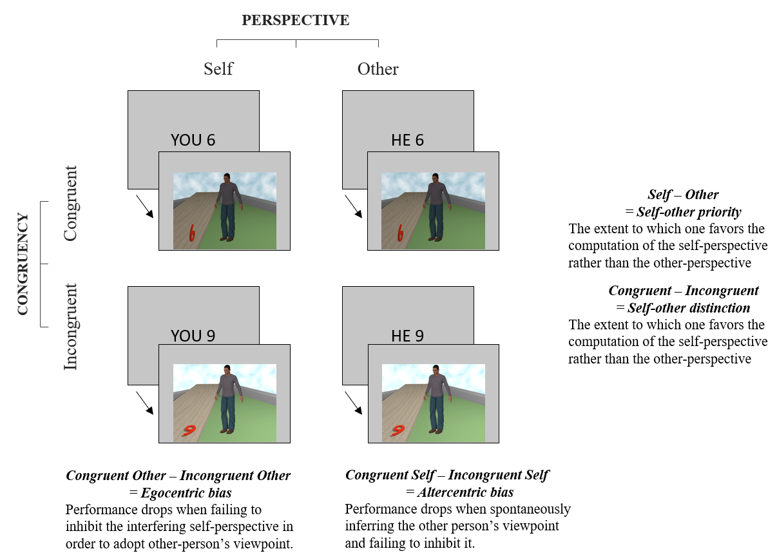
Method – Which facet of PT is impaired ?
SAMPLE
MEASURES
21 ASPD male forensic inpatients
- Diagnosed with MINI and SCID-II
Hospitalized in a high-risk security forensic hospital
« Not guilty for reason of Insanity »
19 male controls
- Tested at home with an experimenter
Visual Perspective-taking Task
Conflict between perspectives
Attentional priority
Interpersonal Reactivity Index
Empathic concern – personal distress
Perspective-taking
Notes:
to adress this issue and to better understand which facet of perspective taking is impaired, we recruited a sample of 21 ASPD and 19 control, all males, to whom we administered the level 2 visual perspective taking task, which is a behavioral task, and also the interpersonal reactivity index, which is a self-reported questionnaire often used to measure empathetic tendencies
On veut donc tester nous meme avec ces 2 dimensions en parallèle, ainsi qu’un questionnaire
Recrutement 21 aspd etc etc

Slide 7
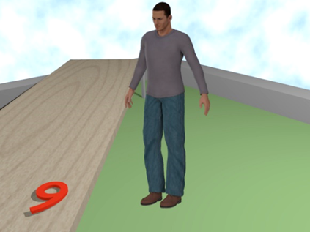
Method: Visual PT task (level 2)
SELF
vs.
OTHER
« Do you see a 9 ? »
« Does he see a 9 ? »
Self-other Priority (SOP)
The tendency to automatically favor the adoption of the self or the other’s perspective
Notes:
To introduce to you the VPT task, let’s imagine you are facing a computer screen on which a scene juste like the one you can see here appears. You are then facing an invidual, and both of you can see a number that is lying down. Now based on the type of trial, as a participant, you can either be asked to adop your own perspective, with the instruction asking whether YOU see a 9; or you can be asked to adopt the perspective of the OTHER, with the instruction indicating so.
Now by comparing the rapidity of response and the accuracy between these two types of trials, it is possible to establish the tendency to automatically favor the adoption of the self or the other’s perspective. This tendency is called self other priority. In other words, in provides an indication of how fast and accurate are you when you have to adopt your own perspective compared to the other’s.

Slide 8
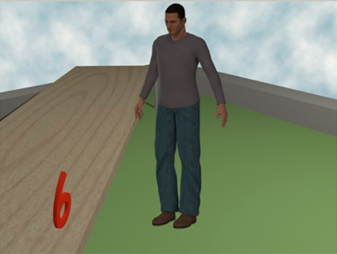
Method: Visual PT task (level 2)
INCONGRUENT
vs.
CONGRUENT
SELF
vs.
OTHER
SELF
vs.
OTHER
« Do you see a 9 ? »
« Does he see a 9 ? »
Self-other Distinction (SOD)
The ability to separate two conflicting perspectives and inhibit an irrelevant perspective
Notes:
A second dimension of this task can be extracted. On this first scene, you can see that your perspective, and the one of the other are different. While you see a 9, he sees a 6. This means that you incongruent perspectives, that there is a conflict between both. Another type of trials is a scene where both of you perceive the same number. This is then a congruent trial, and by comparing the performance of the participant between congruent and incongruent condition, you can establish their ability to separate two conflicting perspectives, and inhibit an irrelevant one. This capacity is called self-other distinction.
Facing a scene: you and an other individual are facing a scene with a number between you
Image 2 apparait: the number can either stand or be laid down, and according to the perspective, can be seen as a 6 or a 9.
When the number is standing, we have congruent perspective: you and the individual perceive the same number
When it’s laid down, then the perspective are incongruent as you and the individual does not perceive the same number
→ Rajouter les flèches

Slide 9
Method: Interpersonal Reactivity Index
Empathic concern
“I often have tender, concerned feelings for people less fortunate than me.”
“When I see someone being taken advantage of, I feel kind of protective toward them.”
Personal distress
“ When I see someone who badly needs help in an emergency, I go to pieces.”
“I tend to lose control during emergencies.”
Perspective-taking
“I sometimes try to understand my friends better by imagining how things look from their perspective”
“I sometimes find it difficult to see things from the "other guy's" point of view.”
Non-isomorphic emotions
-
Emotional contagion
Motivation to take perspective
SOD
SOP
Notes:
We also wanted to investigate these 2 dimensions by using the interpersonal reactivity index. This questionnaire is widely used to measure empathy, but here, we propose an « adapted » reading of the items and the different dimensions.
First, if we look at the empathic concern subscale, we can see that some of the items – here i put 2 to illustrate – actually investigate the sensitivity one has for the other, coupled with the onset of complementary, reactive emotions in response to someone else’s distress.
For instance; « when i see someone being taken advantage of, i feel kind of protective toward them », we can see that there is a consideration, a sensitivity to the other, but also a protective feeling that emerges in response to an unfair situation.
By comparison, the items forming the personal distress subscale also reflects the sensitivy to the other, but this time coupled with some sort of emotional contagion, or disregulated negative emotions in response to a negative stimulus. For instance, « when i see someone who badly needs help in an emergency, i go to pieces »
Now by substracting the two scores, we can obtain a measure than cancels out the sensitivity to the other present in both subscales, and hence represent a score reflective of the ability to inhibit an interfering emotion and respond in an functional, empathetic manner.
Another interesting set of items is the perspective-taking subscale, which represent the motivation one has to adopt the perspective of the other. Hence, this index is highly associated with the self-other priority dimension that was presented just before, as both capture the attentional priority one has for the other. In the two items that you can read here, « i sometimes try to understand my friends better by imagining how things look from their perspectives » and « i sometimes try to understand my friends better by imagining how things look from their perspective », the verb try more concretelly reflect the motivation rather than the capacity.

Slide 10
Analyses: Independant sample T-test (ASPD vs. controls)
Self-other Priority: prioritizing the self or the other perspective
t(38) = -1.491, p = .149 ; M_{ASPD} = 5.26 p.p.(21.72 p.p.) and M_{control} = -2.11 p.p.(6.08 p.p.)
IRI SOP: t(38) = -1.173, p = .248; M_{ASPD} = 30.75 (8.25) and M_{control} = 33.47 (6.17)
OK
Self-other Distinction: distinguishing between self and other perspective
t(38) = -3.275, p = .003 ; M_{ASPD} = 19.07 p.p.(20.13 p.p.) and M_{control} = 4.26 p.p.(4.69 p.p.)
IRI SOD: t(38) = - 2.511, p = .016; M_{ASPD} = 7.00 (7.32) and M_{control} = 12.95 (7.66)
KO
Notes:
To investigate which facet of perspective taking might be impaired in our ASPD group, we conducted group comparison on both VPT dimensions
While no significant difference was found on the self-other priority dimension between the 2 groups, indicating no prioritization for the self or the other’s perspective,
a significant difference was found on the self other distinction dimension. In other words, while no perspective was more easily adopted between the self and the other, the inhibition of an irrelevant perspective was actually more difficult for the clinical group.
Interestingly, the same analyses conducted on the IRI indexes showed similar results, hence supporting the existence of a specific deficit on the self-other distinction dimension.
A negative significant correlation between the IRI’s SOD and the VPT’s SOD index was found, suggesting that a higher difference between the EC and PD scores would predict fewer errors during visual perspective-taking due to conflicting viewpoints
(r(39) = -0.355, p = .025)
In the same vein, a negative correlation was found between the IRI’s PT and the VPT’s SOP median response time (r(39) = -0.401, p = .011), indicating that participants who scored higher on the PT subscale tended to respond faster when they were required to adopt the other's perspective compared to their own in the VPT task. onfusion between the self and the other’s viewpoints

Slide 11

Discussion
Egocentrism ?
No high self-priority but difficulty to inhibit the interfering viewpoint (self or other people perspectives)
Altered sense of self
identity diffusion/
emotional contagion
Emotional outburst
Antagonistic behaviors
Martin et al., 2019
Nalbant, 2022
Velotti et al., 2019
Eddy, 2018; 2022
Luyten et al., 2021
Notes:
To conclude, we saw that to characterize whether the ASPD population could be qualified as egocentric, two dimensions should be investigated. While we observed that no high self-priority was present in this population, they demonstrated greater difficulty at inhibiting an interfering viewpoint, or, in other words, distinguishing their perspective from those coming from the others.
Hence, instead of establishing that the individuals with ASPD are solely egocentric, we can actually say that they are rather facing interferences coming from either their own perspective, that they project onto the others, but also interferences stemming from the others, that hinder the accessibility to the self perspective.
Now differentiating between our own mental state and those of others involves the ability to identify what stems from the self and what stems from others, in order to avoid confusion and preserve the integrity of the self.
An altered sense of self may then lead to an increased vulnerability to emotional contagion, which can culminate in emotional outbursts ((((often observed in ASPD individuals
In that sense, the combination of a weakened sense of self, impaired inhibitory control and aggression can be interpreted as the manifestation of a defective SOD. Hence
, the externalized behaviors displayed by ASPDs, such as harming others for example, may be read as a coping mechanism for the tenuous boundaries between self and the others.
The adoption of such antagonistic behaviors might then be displayed in an attempt to overcome excessive emotional contagion responsible for their personal distress, and to recover a proper distinction between the self and the other

Slide 12
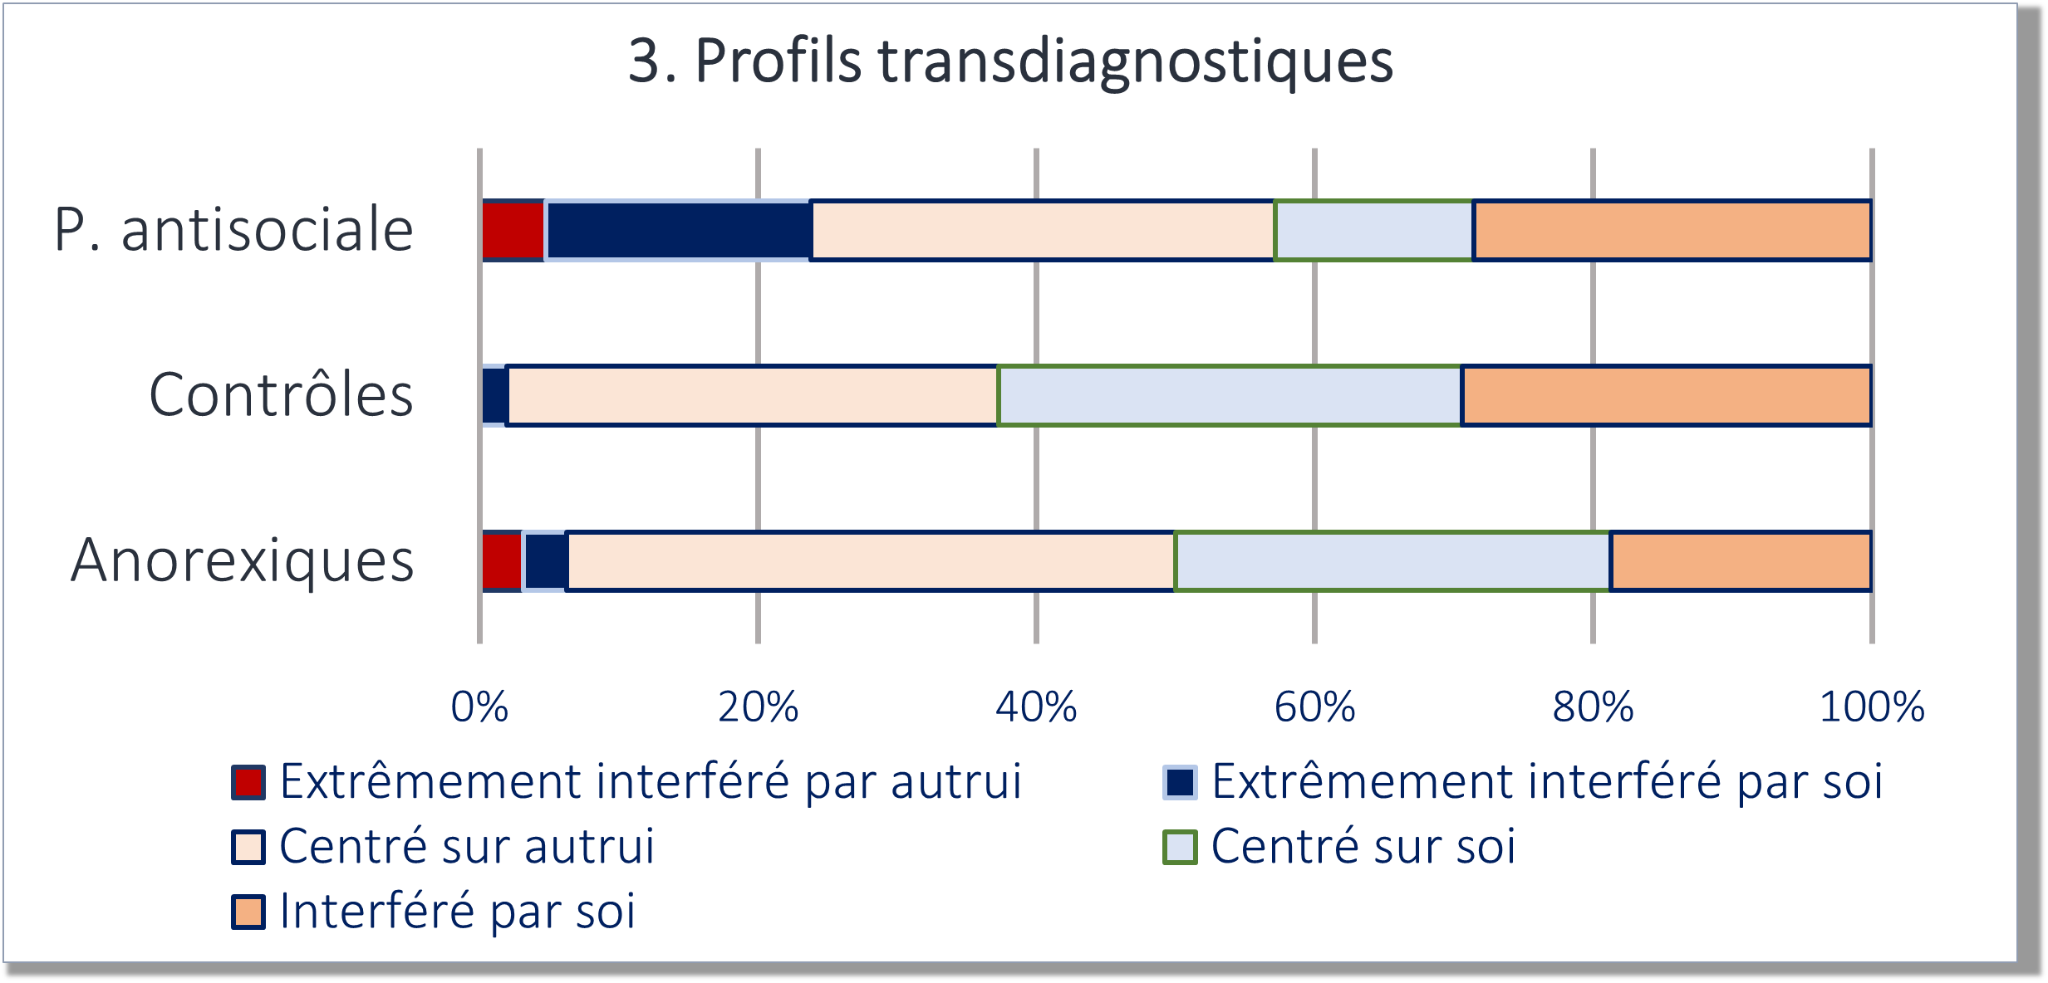
Discussion: Limits
High comorbidity among our sample
  9 participants with psychopathy
Heterogeneity within the population ?
Replication with higher sample
Transdiagnostic profiles
ASPD
Controls
Anorexics
Highly interfered by the other
Other-centred
Interfered by the self
Highly interfered by the self
Self-centred
Notes:
Some limitations need to be pointed out, specifically regarding the sample. While all partcipants were diagnosed with antisocial personality, 9 of them also presented a psychopathic personality. This remains an important limitation as this specific population tend to display better cognitive abilities that are highly solicited in our task, and more generally, present more skills in interpersonal situations.
Beyond this heterogeneity within the sample, it is possible that an heterogeneity exists within the ASPDs, and that multiple profiles of perspective takers could be identified. This goes with the idea that, regardless of the prior diagnosis, some psychopathalogies may share similar impaired socio-cognitive processes, that could be better apprehended using a transdiagnostic approach.
Overall, we aim to replicate these results with a bigger sample to strengthen our conclusions.
Heterogeneity: future perspective, limit, psychopath moins de souci, besoin de + de données

Slide 13

Thank you for your attention !
Alix.bigot@uclouvain.be

