Slide 1




Excess under-5 mortality of children born to immigrants: longitudinal evidence from France
Emmanuel Idohou,
PhD student
Promotors: Philippe Bocquier & Michel Guillot
Second MigrantLife Symposium
June 29-30, 2023, St Andrews

Slide 2
CONTENTS
Introduction
Lit review
Hypotheses
Conclusion
Methodology
Results
i
ii
iii
iv
v
vi

Slide 3

Introduction
Children are facing widespread ethnic disparities in their chances of survival in France (Wallace et al., 2020)
In spite of much progress in child survival (UN IGME,2019)
But, for children of Maghreb women
advantage in BW, PTB and gestational age (Florian et al., 2021) and high IM (Wallace et al., 2020)
  In other context (US for ex ), there is an advantage in terms of IM (Hummer et al., 2007)
The variations in these results raise questions about
the real role of migratory origin in inequalities in child health
the existence of other factors, including that of context
Questions
Are disparities in U5M based on migratory origin attributed to differences in the distribution of confounding variables or to differences inherent in migratory origin ?
Mother's home country effect ? What about other factors

Slide 4
Literature review
Healthy Immigrant Effect (HIE)
Social capital
Discrimination
The attributes of a social organization, including networks, norms, and social trust (Putnam, 1993)
Ex: parental or partner support, % of immigrants in the neighborhood
Intergenerational transfer of health advantages
Evidence on birth outcomes and IM (Hummer et al., 2007)
Country of origin context
occurs during the interaction between caregivers and patients during prenatal or postnatal consultations.
Discrimination adverse birth outcomes
Socio-sanitary characteristics of the country of origin, environmental factors.
For ex: a high IMR of mother’s origin is associated to a higher IMR in Norway (Kinge & Kornstad,2013)

Slide 5
Hypotheses
H₁
Migration background significantly contributes to the U5M disparities, with African immigrants being particularly disadvantaged.
A higher level of development in the country of origin correlates with a decreased U5M
H₂
H₁-H₄
Having the paternal support reduces the risk of U5M
H₃
A higher % of births to immigrant women in the local municipality of birth is associated to a lower risk of U5M. This association is more beneficial for immigrant women compared to native women
H₄

Slide 6
Methodology
01
02
03
04
05
06
Data
Eligibility
Sampling
EDP: the largest French sociodemographic panel
Births in the first 4 days of the first month of each quarter
648,040 births in France from 1990 to 2019
Dependent variable
Independent variables
Statistical analysis
Parental origin = mother’s birth place
Immigrant categories= SSA, North Africa, East Eu, other Eu countries, Asia and others.
Weighting using propensity score (pscore)
Weibull model
1 if children died
before age 5
U5M=
0 otherwise
Level of development=HDI
Paternal support= father's age + father’s surname in the birth certificate
child and parent’s
socioeconomic factors
% of births of immigrant in municipality

Slide 7


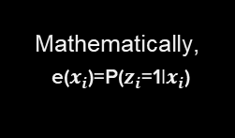
Methodology-pscore
CHOICE OF THE COVARIABLES
BALANCING PROPERTIES OF PSCORE
Based on the results of the O-B decomposition , logistic regression to examine the probability of being born to a native mother based on these explanatory variable
pscore=probability of receiving treatment based on the observed variables between two groups, with one designated as the treatment group and the other as the control group (Rosenbaum et Rubin,1983)
Balances assessed through several tools: covariate balance, visual graphic of the pscore, standardized difference in means or proportions (Diff) and the variance ratios (V.Ratio)
Mathematically,
e($x_{i}$)=P($z_{i}$=1|$x_{i}$)
1
2
3
The use of Weighting method
$w_{i}=\frac{z_{i}}{e\left(x_{i}\right) }$+ $\frac{1−z_{i}}{1−e(x_{i})}$
$$\left\{\begin{aligned}z_{i }=1 for native−born \\ z_{i}=0 for immigrant−born \\ x_{i}=set of covariates for individual i\end{aligned}\right.$$
CHOICE OF APPROPRIATE ESTIMATION METHOD

Slide 8
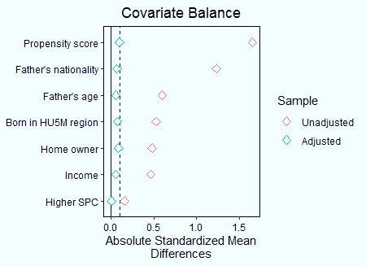
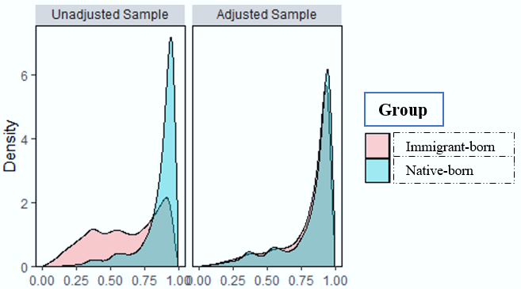
Results-Descriptive analysis
Covariate balance
Distributional balance for pscore
Satisfactory balance for all covariables
The higher SPC exhibits the most favorable balance
The pscore method (PSM) successfully achieved a balance in the characteristics between the two groups, albeit with some minor residual imbalances
Source: Author’s calculations based upon Permanent Demographic Sample (EDP), 1990–2019
HU5M region indicates French regions where the U5M is higher (>=4‰)
Higher SPC includes farmers, artisans, traders, executives and intermediate professions.

Slide 9
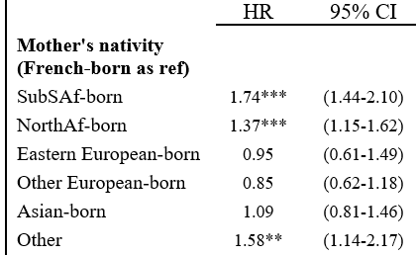
Results-multivariate analysis (1)
Higher U5M among children of immigrant mothers (except from Europe and Asia)
SSA :
North-Africa : 1.15 to 1.62
Total effect
of migratory origin
Intergenerational
transfer of HIE
Discrimination, low SES or risky health behavior …
1.44 to 2.10
These persistent disparities, despite the adjustment of covariables, are likely attributed to migration background indicating its central role in the shaping of U5M inequalities independently of other characteristics
Source: Author’s calculations based upon Permanent Demographic Sample (EDP), 1990–2019, N = 648,040 children born in France. Analyses are weighted. ***p<0.001; **p<0.01; *p<0.05. This model was adjusted for child and parent characteristics, the results of which are not presented here.

Slide 10
Results-multivariate analysis (2)
NB: All these models were adjusted for child and parent characteristics, the results of which are not presented here.
M₁ | M₂ | M₃
Significant influence of
paternal support in line with previous studies (Gaudino et al., 1999, Tan et al., 2004, DeSisto et al.,2018)
the level of development on U5M consistent with the positive association between IMR in the mother's country of origin and IMR in Norway (Kinge & Kornstad, 2013)
% of births of immigrant not consistent with inverse association between the % of immigrants in the neighborhood and PTB among Sub-Saharan African women but consistent with the positive relationship for French natives (Zeitlin et al., 2011)
Paternal support (No)
0.58*** (0.48-0.70)
0.56*** (0.46-0.68)
0.56*** (0.46-0.68)
HDI
0.33** (0.15-0.72)
Prop of births (High)
0.61*** (0.51-0.74)
Prop of births x Migratory status
Foreign-born x High
1.86*** (1.47-2.34)
Foreign-born x Low
1.28*** (1.14-1.44)
French-born x High
1.82*** (1.43-2.31)
Source: Author’s calculations based upon Permanent Demographic Sample (EDP), 1990–2019, N = 648,040 children born in France. Reference categories are in parentheses. Analyses are weighted. ***p<0.001; **p<0.01; *p<0.05.

Slide 11
Conclusion
Lessons learned
Strengths
Limitations
H₁-H₃
Weighting technique used to address bias arising from differences in observable characteristics and to clarify the real role of migration background in inequalities in the U5M
PSM is sensitive to the choice of variables based on observable characteristics. This may introduce bias due to unobservable factors (Lecocq et al., 2016)
H₄
The important role of migration background in U5M inequalities
The longitudinal approach used, ensures reliable regression estimates (Bocquier et al., 2019)
Does paternal support, as measured, really reflect involvement or support during pregnancy ?
The crucial role of the home country context, paternal support and the clustering of births to children of immigrants on child survival
Contribute to enrich research into children's health by taking into account overlooked factors like home country context and paternal support
What about biomedical and health behavior variables during pregnancy ?

Slide 12
Thanks!
Thanks to
Louvain4Migration for funding access to the EDP data and FNRS for funding my research fellowship
Do you have any questions?
emmanuel.idohou@uclouvain.be

