Slide 1
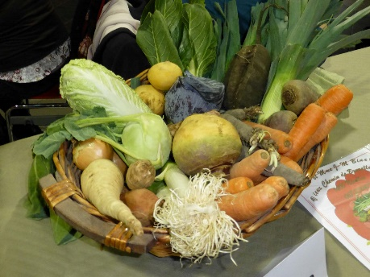


Towards Redesigning the
Global Seed Commons
International Workshop
The Commons, Plant Breeding and Agricultural Research
Maison Française d’Oxford, 2016
FAO/G. Napolitano
Christine Frison
PhD Research Fellow
Université catholique de Louvain
University of Leuven
FAO/A. Vitale

Slide 2
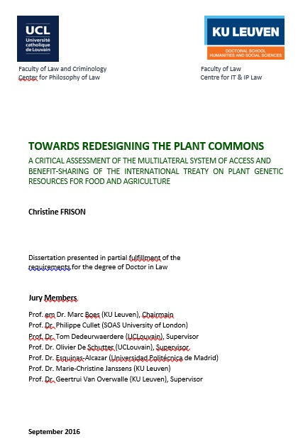
Overall research question
“Why are current seed exchanges problematic and how can conservation, sustainable use, and access and benefit-sharing provisions under the Treaty be promoted for food security and sustainable agriculture purposes using the theory of the commons?”

Slide 3
Research structure
3 part thesis
  Part 1 is descriptive and looks at the past (i.e. what existed before the Treaty?)
  Part 2 is evaluative and analyses the present (i.e. how does the Treaty function?)
  Part 3 is normative and envisages the future (i.e. how should the Treaty be implemented to effectively reach its objectives?)

Slide 4
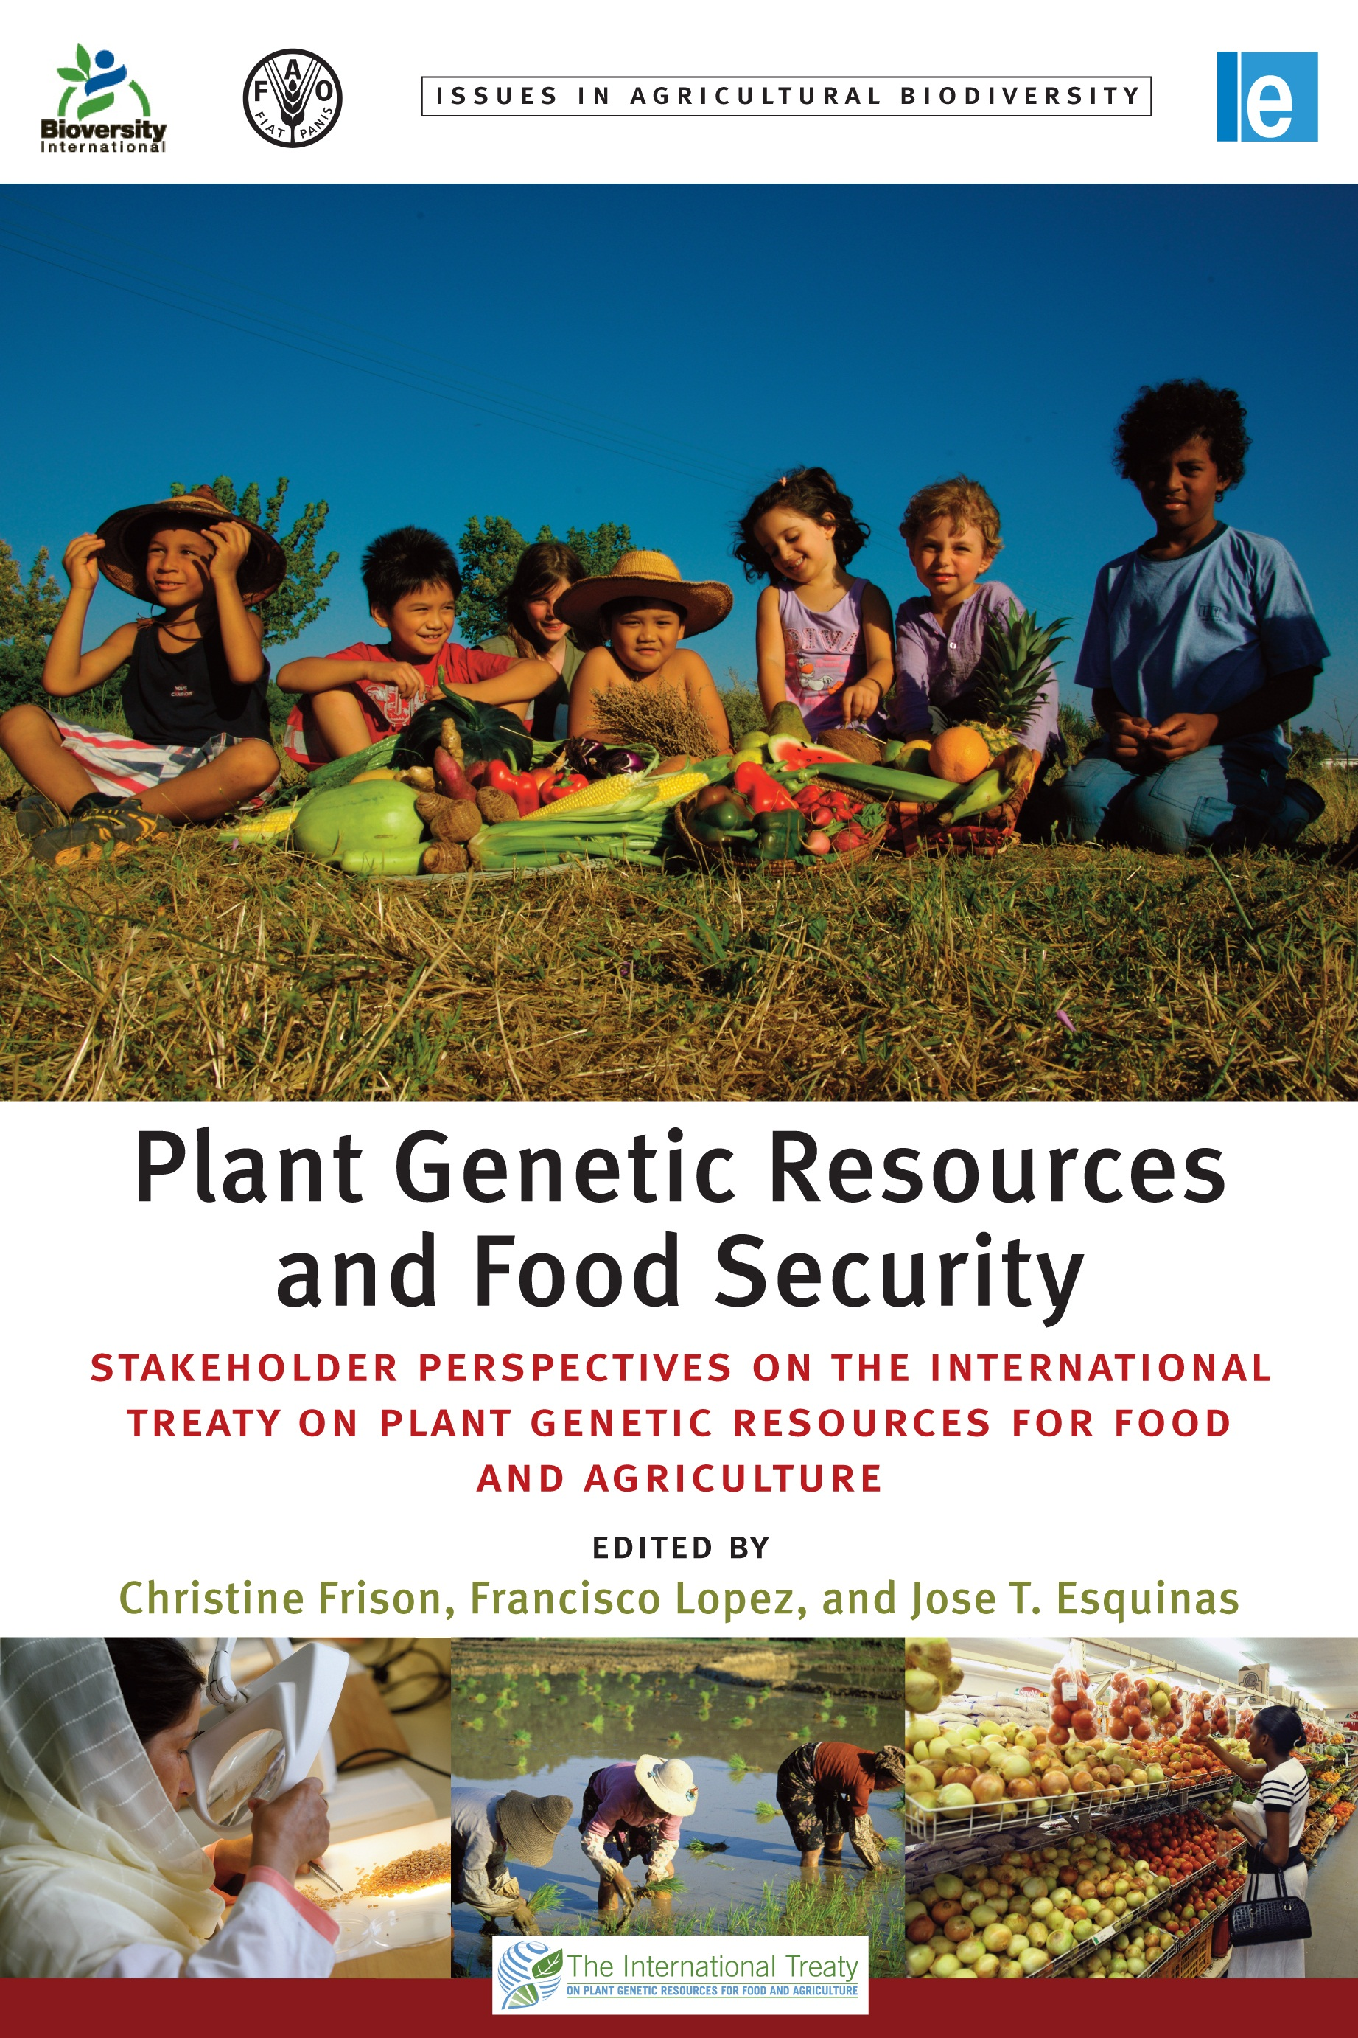
Research Methods
3 types of analyses
  Part 1: contextual analysis -> understand
  general issues at stake
  Part 2: legal analysis (legal interpretation of Treaty clauses) -> identify conceptual Treaty constraints
  & stakeholder analysis (socio-anthropologically inspired method: book) -> identify list of 17 constraints
  Part 3: analyze part 2 results through the lens of the commons theory -> propose conceptual solutions to Treaty constraints

Slide 5
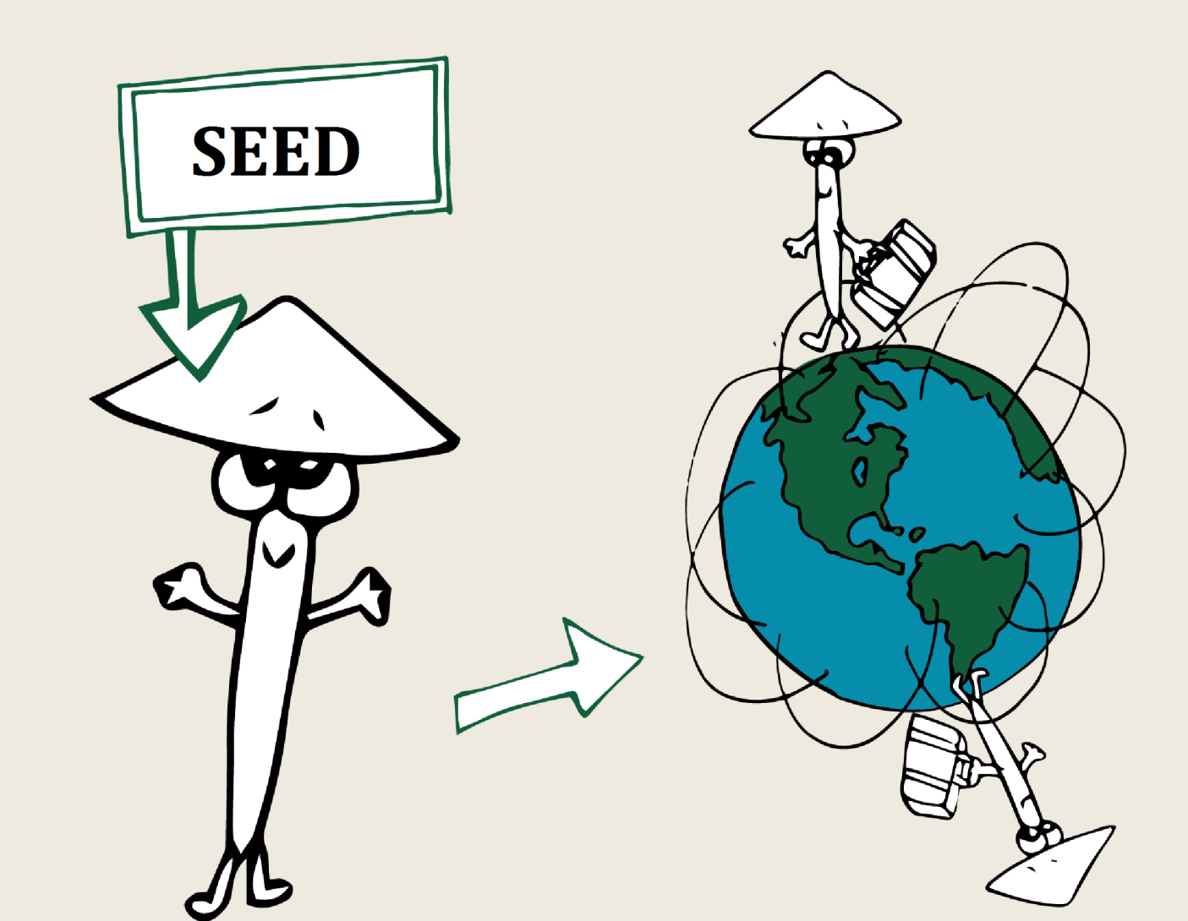
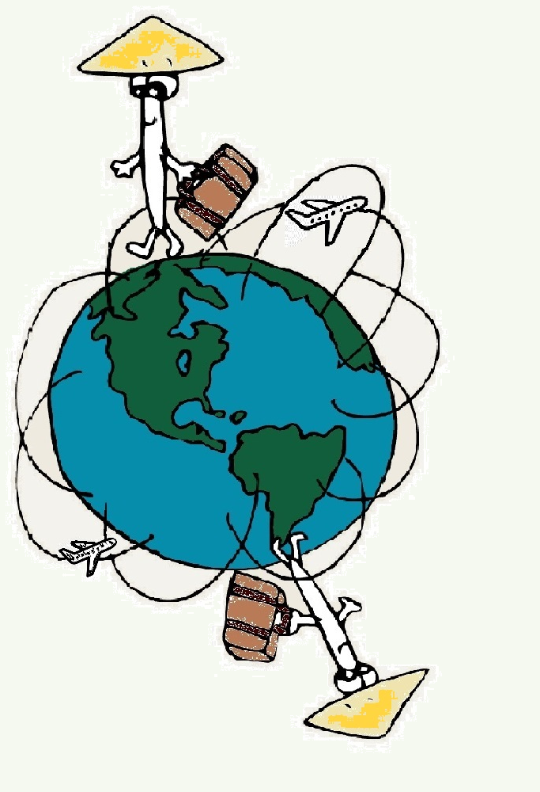
Flash history of the seed (plant genetic resources for food & agriculture)
Since the beginning of agriculture, seed access, use and exchange has been unfettered
Flow
Use / Conservation
Diversity
!
ACCESS

Slide 6
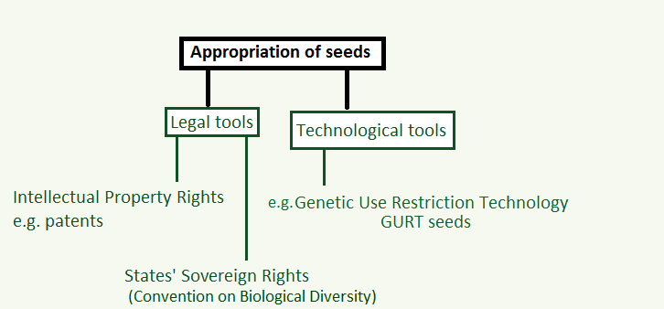
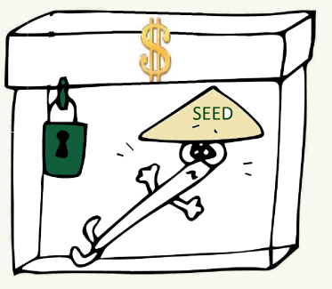
Over the last decades, commodification of seeds has rendered access to seeds more and more difficult, leading to erosion
(Safrin 2004 on “hyper-ownership”)

Slide 7
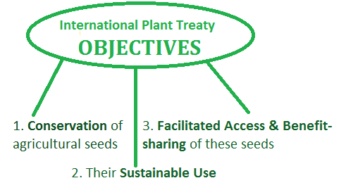
As a response, the International Treaty on Plant Genetic Resources for Food and Agriculture was adopted (2001-2004)
+ Overall goals:
Food Security & Sustainable Agriculture
+ Recognition of Farmers’ Rights (Article 9)
Notes:
140 Contracting Parties in June 2016
Adopted on 3 November 2001 – entered into force on 29 June 2004
Beginning of effective implementation around the years 2010-2011 after the creation of necessary tools (SMTA 2006-7, BSF 2008-10, 3PB 2010, GLIS 2015-17, etc.)
FRs’= right to use, save, sell and exchange seeds subject to national legislation; protection of TK; right to equitably participate in sharing benefits; and right to participate in making decisions
Article 9 - Farmers's Rights
9.1 The Contracting Parties recognize the enormous contribution that the local and indigenous communities and farmers of all regions of the world, particularly those in the centres of origin and crop diversity, have made and will continue to make for the conservation and development of plant genetic resources which constitute the basis of food and agriculture production throughout the world.
9.2 The Contracting Parties agree that the responsibility for realizing Farmers's Rights, as they relate to plant genetic resources for food and agriculture, rests with national governments. In accordance with their needs and priorities, each Contracting Party should, as appropriate, and subject to its national legislation, take measures to protect and promote Farmers's Rights, including:
(a) protection of traditional knowledge relevant to plant genetic resources for food and agriculture;
(b) the right to equitably participate in sharing benefits arising from the utilization of plant genetic resources for food and agriculture; and
(c) the right to participate in making decisions, at the national level, on matters related to the conservation and sustainable use of plant genetic resources for food and agriculture.
9.3 Nothing in this Article shall be interpreted to limit any rights that farmers have to save, use, exchange and sell farm-saved seed/propagating material, subject to national law and as appropriate.

Slide 8
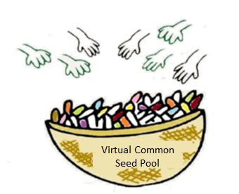
These objectives are to be reached through the establishment of the Multilateral System of Access and Benefit-sharing (MLS)
« Global Seed Commons » for food security and sustainable agriculture
Facilitated access through a virtual common basket of seeds
and the use of a standard access contract (SMTA)
Aims at providing money to the Benefit-sharing
Fund (BSF = collective trust account to fund
farmers’ projects for sustainable use of seeds)
Third Party Beneficiary = guaranties that facilitated access is respected
Global Information System (GLIS)
Etc…
Notes:
MLS = Annex I list of 64 crops and forages for food and agriculture
Facilitated access = the first benefit-sharing result
BSF has already conducted 3 call for project cycles and the 4th is ongoing but serious money problem: the US$ 116 million target to be reached by December 2014 still not reached (only approximately half of the money was provided). Aims at sharing the monetary and non-monetary benefits of the MLS with farmers from developing countries who conserve and sustainably use crop diversity
3PB: introduced in the SMTA as institutional mechanism to guarantee compliance with SMTA obligations in the triangular relationship between the provider and recipient of the seed and the MLS as virtual entity from which the seed derives and whereto the benefits should flow.
Les états décident de rendre commun l’accès à leurs ressources en créant un panier commun virtuel d’échange de semences = expression de la souveraineté des Etats.
64 de nos espèces cultivées majeures (représentant à elles seules 80 % de la consommation humaine) !!! Pas de construction physique d’une méga banque de gènes à la FAO!!!
En facilitant la recherche, l'innovation et l'échange d'information sans restrictions, sont épargnés le temps et l'argent dévolus aux négociations des contrats entre les sélectionneurs et chaque banque de gènes prise individuellement.
Les collections des banques de gènes locales, nationales ou internationales qui sont dans le domaine public ont de règles communes pour l'accès. Ceci comprend les grandes collections du Groupe consultatif pour la recherche agricole internationale (GCRAI), un consortium de 15 centres internationaux de recherche.
L’accès se fait via un accord type de transfert de matériel (ATTM) qui utilise un modèle standard. Ce sont des accords privés entre les fournisseurs et les bénéficiaires.
d the MLS as virtual entity from which the seed derives and whereto the benefits should flow.

Slide 9
The MLS manages seeds in a creative and collective way.
But is it functioning effectively?
Facilitated access to seeds: CGIAR continues to actively distribute seeds from its collections but this is not the case for many contracting parties
BSF: Very little money, especially in the eyes of developing countries & difficult valuation of non-monetary benefit-sharing
Third Party Beneficiary: Seems to function effectively (but only when triggered)
Issues about participation in decision-making of all seed users (and above all farmers)
Timid recognition of Farmers’ Rights at the international law level
Notes:
CGIAR = Consortium of 15 international agricultural research centers for development which main objectives are the conservation, improvement and distribution of seeds, mainly to developing countries
MLS facilitated access to seeds = 80 % of CGIAR distribution of seeds
FRs: recognition and implementation left to national discretion

Slide 10
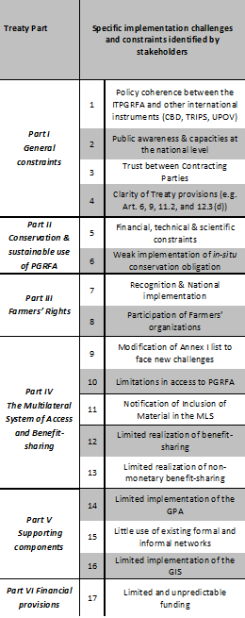
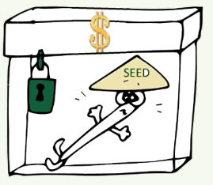
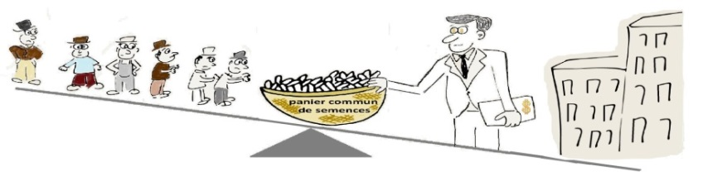
Results Part 2:
Several Treaty constraints identified
    Seed hyper-ownership
    & ‘over-IPRization’
    Imbalance of rights penalizing farmers
    Absence of all stakeholders’ participation
    Dichotomy of scope & objectives of the Treaty versus MLS
    Limited benefits
    Etc…

Slide 11
Constraints categorized by Treaty topics
Sustainable agriculture & food security
2. Scope
3. Farmers’ Rights
4. Facilitated access
5. Benefit-sharing / Benefit-sharing Fund
6. Information / knowledge
7. Third Party Beneficiary
8. Participation / governance
FAO photo
31

Slide 12
What’s working in the Treaty?
Undeniably, the Treaty has created innovative tools and instruments under international law
Sustainable agriculture and food security
Scope
Farmers’ Rights
Facilitated access
Benefit-sharing / Benefit-sharing Fund
Information / Knowledge
Third Party Beneficiary
Participation / governance
Works for the community of researchers and breeders
Is being developed (with a focus on answering the needs of researchers and breeders)
Has been triggered once and seems to function efficiently (but only when triggered)
J.T. Esquinas
Notes:
(1) The DivSeek initiative
(2) The Global Open Genome Sequence Data Framework

Slide 13
What doesn’t work with the Treaty?
Overall goals not reached
Dichotomy of scope Treaty / MLS
Not recognized at Int’L level
No money, little sharing of benefits
No participation of main world food producers in Treaty governance
Sustainable agriculture
and food security
Scope
Farmers’ Rights
Facilitated access
Benefit-sharing / Benefit-sharing Fund
Information / Knowledge
Third Party Beneficiary
Participation / governance

Slide 14
In 2013, the Governing Body of the Treaty decided to initiate a complex review process
Enhance the MLS:
Widening the list of seeds to be accessed through the MLS? -> yes if we change our perception of seeds as exploitable resources
Reviewing the SMTA (in particular the payment scheme)
Identifying where /why countries have difficulties in providing access
Review the Funding Strategy to secure sufficiently stable & long-term funding
Review the payment schemes and rates to fund the BSF (to make it more attractive to the seed industry) -> wrong direction; need to dissociate funding sources from accessing material
Identify other potential sources of funding
BUT: review process seems to get entangled in increasing complexity
need to simplify the system & enhance its “commons” aspect
Presumption of inappropriateness:
make sure that the tools enable to reach the set objectives

Slide 15
“Why are current seed exchanges in the Treaty problematic?”
Tools and instruments of the Treaty express the current imbalance of rights
(building the funding strategy around IPRs de facto imposes the IPR system as being
the “default ” system, which in
turn fragilizes and marginalizes
further farmers’ system)
The whole concept of ABS as a solution to conservation and sustainable use issues has to be rethought (ABS = one means to appropriate nature = contains the intrinsic failure to reach its objectives)
Small-scale farmers (producing 70% of world’s food) are excluded from the governance of the MLS and from their ancestral role of innovators, guardians, and elements participating to the dynamic evolution of varieties
Need to rethink our way of apprehending resources / nature: fundamental conceptual shift needs to occur from “seeds being resources to be managed” to “seeds as element of our ecosystem with which humans have to interact with respect”

Slide 16
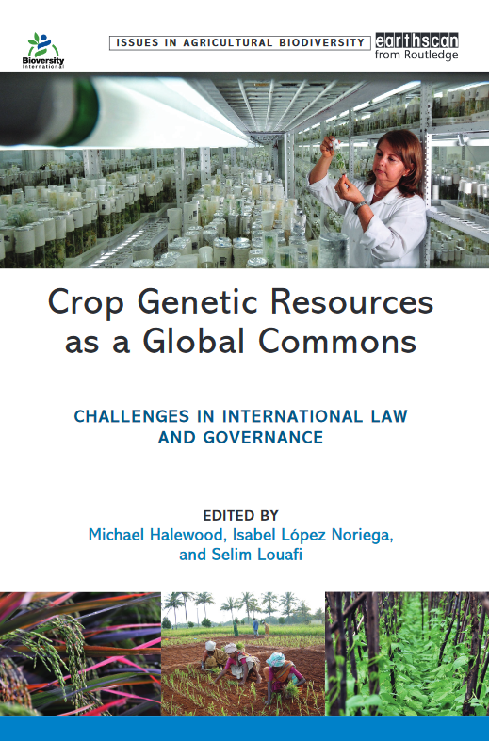
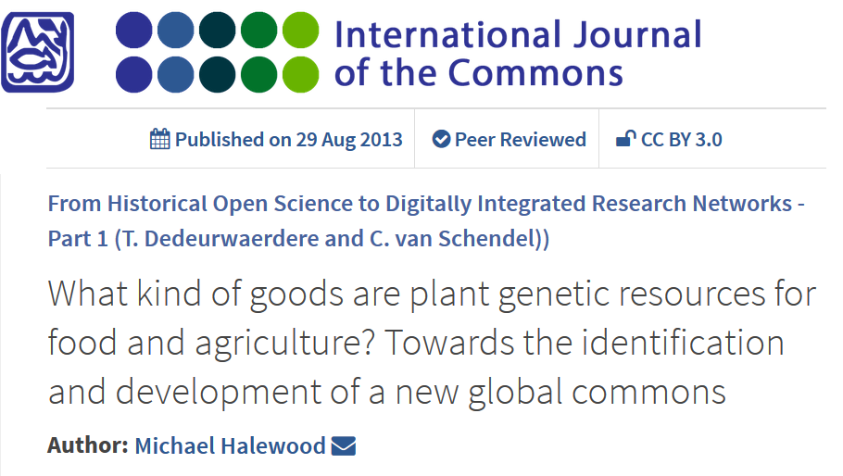
“How can conservation, sustainable use, and access and benefit-sharing provisions under the Treaty be promoted for food security and sustainable agriculture purposes using the theory of the commons?”
Authors (Halewood et al.) have suggested that the MLS could be assimilated to a Global Crop Commons
Notes:
Clearly defined boundaries (i.e. effective exclusion of external unentitled parties);
Congruence between appropriation and provision rules and local conditions;
Collective-choice arrangements (i.e. allow most resource appropriators to participate in and modify the operational rules);
Effective monitoring (by monitors who are part of or accountable to the appropriators);
Graduated sanctions (scale of sanctions for appropriators violating community rules);
Conflict-resolution mechanisms (cheap and of easy access);
Minimal recognition of rights to organize (the self-determination of the community is recognized by higher-level/governmental authorities);
Plus, for CPRs that are parts of larger systems:
Nested enterprises (organization in the form of multiple layers of nested enterprises, with small local CPRs at the base level).

Slide 17
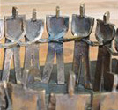
Input from the Theory of the Commons?
8 design principles: useful but several design principles do not match so well with the Treaty and its instruments (Ostrom 1990)
+ the theory has developed with many new scholars feeding it
I posit that the “philosophy” of the commons (commoning?) is useful to design an effective reviewed MLS, i.e. towards a (political) Global Seed Commons? (Bollier, Dardot & Laval, Mattei)
Sculpture: Claude Spièce
“The spread of the commons discourse in recent
Years has had a double effect; it has helped identify new commons and,
in providing a new public discourse, it has helped develop these commons by enabling people to see them as commons.” David Bollier (2007)

Slide 18
      How to design a more effective Global Seed Commons?
      (From an institutional to a political construct of the commons)
    Analysing the Treaty in light of the commons theory, I identified six intrinsic values / underlying principles, particularly relevant for the functioning of the MLS:
    Sustainability
    Interdependence as central criterion
    Anti-commons dilemma: under-use of seeds as main risk for erosion (Heller 1998, Heller & Eisenberg 1998)
    Physical and informational components inextricably bound to the use of seeds (Dedeurwaedere 2012, Batur & Dedeurwaerdere 2014) + cultural aspects
    Global Seed Community: Stakeholder participation
    Diversity, heterogeneity & complexity = > space for pluralism
Notes:
2. interdependence: map of interdependencies of states
Source: Primary regions of diversity of major agricultural crops are distributed across the tropics and subtropics, extending into temperate regions in both hemispheres. Khoury et al. (2015) “Where our food crops come from: A new estimation of countries’ interdependence in plant genetic resources”, CIAT Policy Brief No. 25. Centro Internacional de Agricultura Tropical (CIAT), Cali, Colombia. 4 p.
La durabilité comme objectif central
Responsabilité inter / intra-générationnelle
‘Ecology of law’: approche holistique
Participation de tous les acteurs
Prise de décision collective
Balance des pouvoirs
Interdépendance & autonomie
Global Seed Community
Confiance
Relation/dialogue
Reconnaissance de tous les acteurs de facto (vs. de jure)
Modularité & hétérogénéïté de la structure organisationnelle
Complexité & incertitude des sytèmes
Evolution de type ‘double-hélice’ (vs. linéaire)
Processus: adaptation aux changements

Slide 19
  Results and recommendations for current Treaty review process
Treaty topics | Conceptual constraints | Recommendations
Sustainable agriculture & food security | Overall goals of Treaty not reached inter alia because not recognized as direct objectives | Formally recognize food & nutrition security and sustainable agriculture as direct objectives of the Treaty
2. Scope | Difference between scope of Treaty and scope of MLS leading to dysfunction | Harmonize the scope of the MLS with that of the Treaty to include all PGRFA Expand the Treaty boundaries to make it truly global
3. Farmers’ Rights | No recognition of farmers’ role in PGRFA management and of their associated rights at the international level in the same terms as IPRs | Formally recognize Farmers’ Rights at the international law level Commit to implement these rights at the national level
4. Facilitated access | Facilitated access is absent for the ultimate beneficiaries i.e. farmers | Recognize a direct facilitated access to PGRFA for farmers Promote sui generis PVP systems to recreate effective farmers’ exemption

Slide 20
  Results and recommendations for current Treaty review process
Benefit-sharing/ Benefit-sharing Fund | Farmers are put in a passive situation of beneficiaries denying their de facto active role as main stakeholder in the food production chain | Benefits of the Treaty should reach all beneficiaries Reposition Farmers as active stakeholders in the Treaty, MLS and BSF management
6. Information / knowledge | Appropriation, Protection Availability mainly of one type of information of interest to breeders | Develop the GLIS keeping in mind the overall goals of the Treaty and the needs of smallholder farmers Seek means to turn the MLS into a space where traditional knowledge would be protected from misappropriation
7. Third Party Beneficiary | Preservation of MLS rights, but not preservation of all stakeholders’ rights. Lack of system to balance powers | Advertise on the 3PB’s role & procedures to the Treaty community and the public Deal with 3PB cases in a more transparent way Expand 3PB’s mandate to compliance
8. Participation / governance | Governance of MLS remains at state level Lack of inclusion of all stakeholders at all levels Problem of trust | Allow all stakeholders to effectively participate in the global seed commons governance -> towards a “O.2 World Committee on Food Security”?

Slide 21
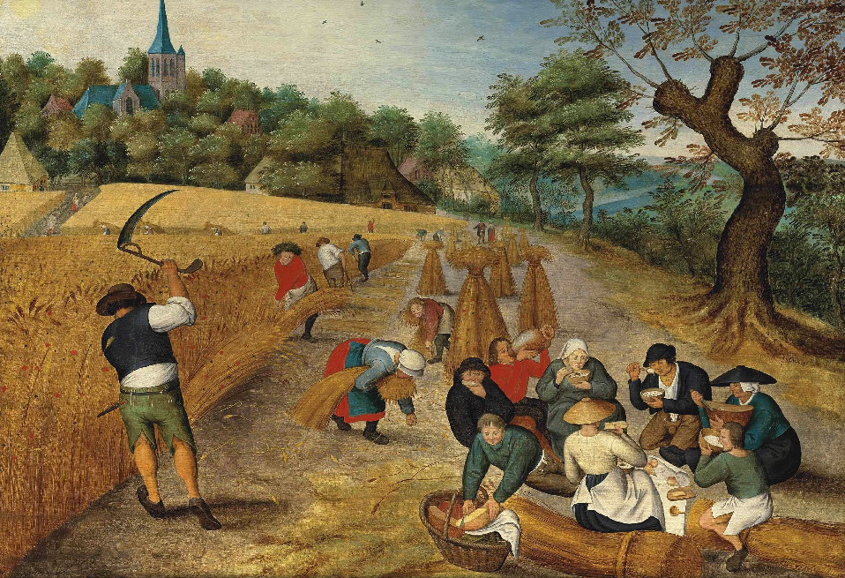
  But we should go further:
Towards a holistic approach to the “world materiality-seed-human” relationship? (e.g. ‘Ubuntu’, ‘Pachamama’, etc.)

Slide 22
International Workshop
The Commons, Plant Breeding and Agricultural Research
Maison Française d’Oxford, 2016
Thank you
Comments are very welcome ☺
christine.frison@uclouvain.be
Follow me on https://www.researchgate.net/profile/Frison_Christine
Centre for Philosophy of Law - Université catholique de Louvain
Centre for IT & IP Law - University of Leuven
FAO/G. Napolitano
FAO/M. Bleich

