Slide 1




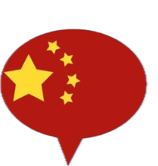
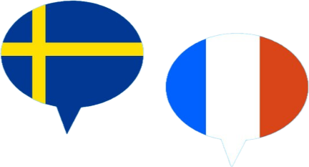


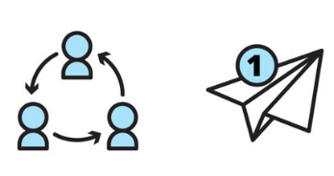


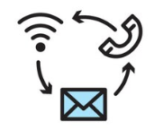



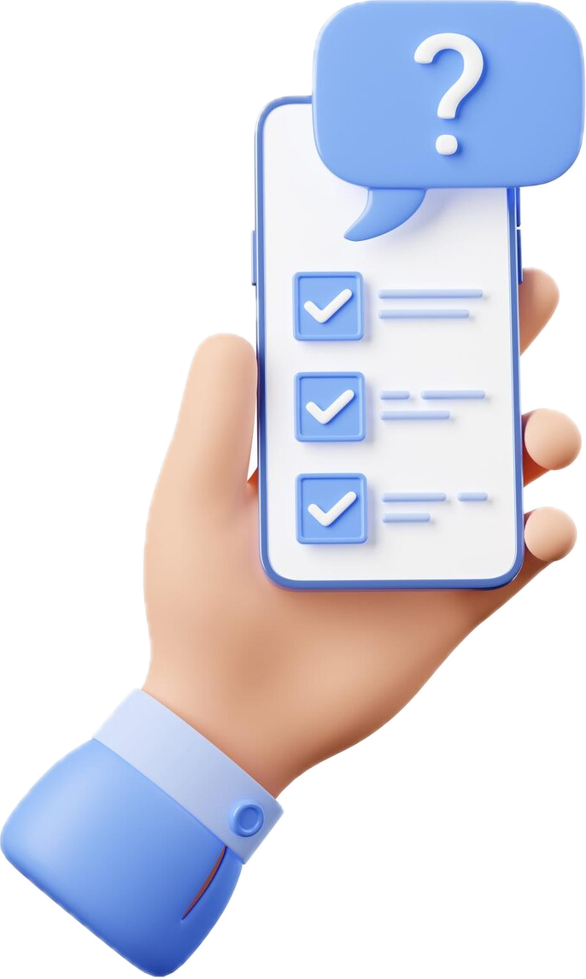

An exploration of business genres and business languages in the online communication of companies operating in multilingual markets
Florence Detienne
florence.detienne@uclouvain.be
Supervisor: Sylvie De Cock
Background & Rationale
Business communication ‘can be viewed as ‘an integrated “umbrella” concept covering all formal and informal communication within a business context, using all possible media, involving all stakeholder groups, operating both at the level of the individual employee and that of the corporation.’ (Louhiala-Salminen, 2009: 312)
Genres
Multilingual Business Communication
’Recognizable communicative events, characterized by a set of communicative purposes identified and mutually understood by members of the professional or academic community in which they regularly occur.’ (Bhatia, 2004: 23)
Business English as a lingua franca (BELF) | Focus on global internal business communication: Comprehensibility Accents
Local languages | Hindering trade Influencing social identity & group formation Shaping environment perception & attitudes
BELF & local languages | Focus on advertising (Hornikx & van Meurs, 2020): Frequency of foreign languages Effects & attitudes towards foreign languages in ads Connections of products with foreign languages
  Business English as a lingua franca (BELF):
  main focus on global internal business communication:
      Comprehensibility; accents; cultural differences (Gerritsen & Nickerson, 2009)
  Local languages : an obstacle to trade;
  influencing social identity & group formation, shaping environment perception & attitudes (Tenzer et al., 2017)
  BELF & local languages: main focus on advertising:
      Frequency of, effects & attitudes towards and connections of products with foreign languages (Hornikx & van Meurs, 2020)
Cultural differences
(Gerritsen & Nickerson, 2009)
  Business genres studied independently of one another, e.g.:
      emails, meetings, press releases
  Focus on lexis & grammar (Gerritsen & Nickerson, 2009)
  & communicative setting & purpose (Bhatia, 2014)
(Tenzer et al., 2017)
Louhiala-Salminen (1999)
Angouri & Marra (2010)
Catenaccio (2008)
PhD Project: Business Genres & Languages in Online External Communication
Aim: Investigate the business genres that feature on the websites, and some of the social media accounts of a sample of companies operating in Belgium, Luxembourg and Switzerland, with a particular focus on the language(s) they are available in and on the interplay between language use, the genres’ communicative purposes and target audience(s), and corporate identity.
Research Questions
  Do companies tend to publish content in English and/or local languages on certain online communication channels?
  Do certain business genres tend to be published on specific online communication channels?
  Do certain business genres tend to be published in specific languages (local and/or English)?
  To what extent is the online external communication of companies integrated
  in terms of content, genre and language?
  To what extent is the use of language(s) in line with the companies’ language management strategy and corporate identity?
Data
Methodology
  Content published
      by companies operating in countries with several official languages, none of which is English:
      Belgium , Luxembourg , Switzerland
      on their websites & social media accounts
  Questionnaires & interviews with
  communication officers
Identification of | Online business genres Available languages Communicative purposes and target audiences
Corpus-based analysis | Genres’ lexico-grammatical features Expressions of corporate identity
Insights from questionnaires/ interviews | Language management strategy Corporate identity Integrated communication
References
  Angouri, J. & Marra, M. (2010). Corporate meetings as genre: a study of the role of the chair in corporate meeting talk. Text & Talk 30(6), 615-636.
  Bhatia, V. (2004). Worlds of Written Discourse - A Genre-based View. London: Continuum.
  Bhatia, V. (2014). Analysing discourse variation in professional contexts. (2014). In:
  Bhatia, V. (ed.), The Routledge Handbook of Language and Professional Communication, 3-13. London: Routledge.
  Catenaccio, P. (2008). Press Releases as a Hybrid Genre: Addressing the Informative/Promotional Conundrum. Pragmatics 18(1), 9-31.
  Hornikx, J., & van Meurs, F. (2020). Foreign Languages in Advertising: Linguistic and Marketing Perspectives. Cham: Palgrave Macmillan.
  Gerritsen, M., & Nickerson, C. (2009). BELF: Business English as a Lingua Franca. In F. Bargiela-Chiappini (ed.), The Handbook of Business Discourse, 180-192. Edinburgh: Edinburgh University Press.
  Janich, N. (2017). Genres in the business context: An introduction. In G. Mautner & F. Rainer (eds.), Handbook of Business Communication 13, 41-62. Boston, Berlin: De Gruyter.
  Louhiala-Salminen, L. (1999). "Was There Life Before Them?": Fax and E-Mail in Business Communication. Journal of Language for International Business 10 (1), 24-42.
  Louhiala-Salminen, L. (2009). Business communication. In F. Bargiela-Chiappini (ed.) The Handbook of Business Discourse, 305-316. Edinburgh: Edinburgh University Press.
  Nickerson, C., & Planken, B. (2009). Europe: the state of the field. In F. Bargiela-Chiappini (ed.), The Handbook of Business Discourse, 18-29. Edinburgh: Edinburgh University Press.
  Tenzer, H.; Terjesen, S.& Harzing, A.-W. (2017). Language in International Business: A Review and Agenda for Future Research. Management International Review 57, 815-854.
Notes:
Business: https://fr.freepik.com/vecteurs-libre/contactez-nous-icones-sketch_4611201.htm#fromView=search&page=1&position=42&uuid=20c0b81d-05e6-4086-ad85-e99d7ff11303&query=business+mail+drawing
https://fr.freepik.com/vecteurs-libre/icones-ligne-medias-sociaux-definies-pour-communication-par-courrier-electronique-communaute-internet-partage-reseau-groupe_4425891.htm#from_element=detail_alsolike
Data image: https://fr.freepik.com/vecteurs-libre/illustration-hebergement-site-web-design-plat-dessine-main_21695615.htm#fromView=search&page=1&position=13&uuid=2cf6bd15-e3e6-4fff-b219-663a4c0bb98e&query=data+computer
https://fr.freepik.com/vecteurs-libre/personnes-detenant-icones-cercle-copie-espace-connecte_3425202.htm#fromView=search&page=2&position=5&uuid=92ea181c-5ec2-478e-953a-9bd625e77291&query=integrated+communiation

