Slide 1


An “Embodied" Reading of John 15
By Two Women In the 14th and 20th Centuries
Florence Draguet
UCLouvain - RSCS
Female Corporeality and Religion
Centre for Women’s Studies in Theology KU Leuven
1st - 3rd June, 2023

Slide 2
Introduction
“Abide in me and I in you” (John 15,4a) - “I appointed you, that you may go and bear fruit” (John 15,16a)
Does a woman understand these verses in the same way as a man?
What impact might her bodily experience have on her interpretation of the text?
Who are Catherine of Siena and Adrienne von Speyr
Some points in common in their relationship to the body and to motherhood
Some characteristic features in relation to our question, the pericope of the Vine and the branches
Observations

Slide 3
Conclusion
Does a woman read a verse such as "Remain in me and I in you" or "I have chosen you that you may bear fruit" in the same way as a man? What impact might her bodily experience have on her interpretation of the text?
Not a question of the bodies of women that would bear life in them
But particularly developed attention to the body of the Church
A hierarchical body and importance of the obedience
Less conceptualising, more incarnational reading ?
AND which place into this ecclesial body?
BUT women no priest!
Intvitation to reread not with one's mind alone, but with all one's senses, with one's whole body, the lines left by the saint of Siena and by the doctor of Basel.

Slide 4
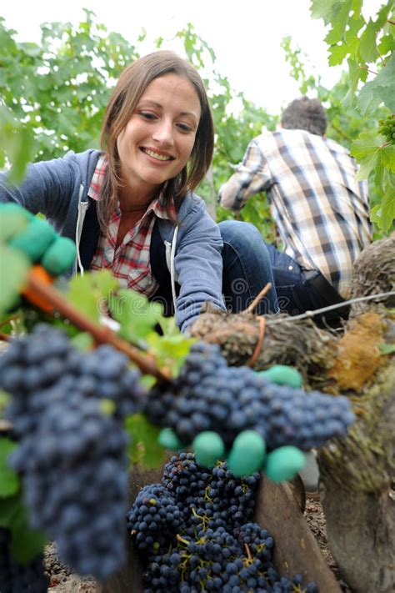
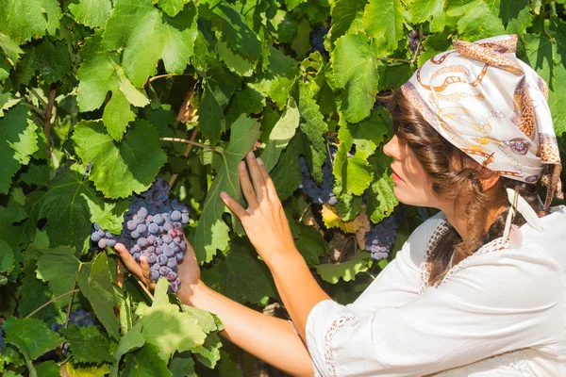
Thank you for your attention
Notes:
Thank you for your attention.

