Slide 1
Jean-Marc Ferry and Jörn Rüsen’s stances on history and on historiography
From a critical perspective to a humanistic one
Geneviève Warland (UCL, Belgium)

Slide 2
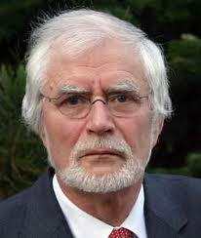
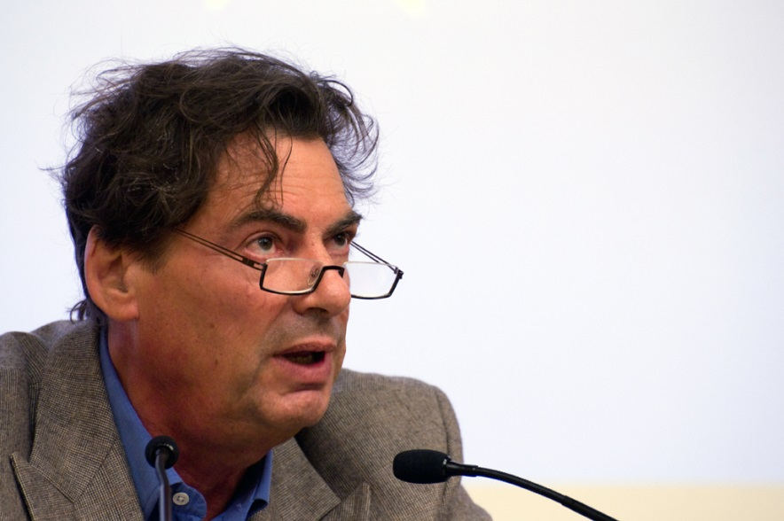
Jörn Rüsen
Jean-Marc Ferry

Slide 3
Ferry’s pragmatic stance on history: for a public European culture
Universalistic foundations of Europe: principles of civility, legality and publicness
European history as a set of positive and negative historical experiences
Critical appropriation of European historical legacies : historical justice and reconstructive ethics as well as postnational education

Slide 4
Ferry’s principle of the self- recognition in the other
Constitution of a European historical consciousness by opening and decentering national memories
Ferry’s stance on history in the European context subordinates historical study and experience to politics and to ethics by stressing norms and values
Holocaust as a categorical imperative for relating to the past and the future

Slide 5
Rüsen and the social function of history against ethnocentrism
Practical functions of historical knowledge: 1) to build identities; 2) to criticize ideological uses of history
Historians’ cognitive responsibility: reflexive historiography
Historians’ social responsibility and the fight against ethnocentrism
Constitution of a European historical consciousness by creating common historical patterns and by taking into account the burdens of European history (wars, colonialism)

Slide 6
Rüsen’s principle of the mutual recognition of differences
Otherness of different cultures as a mirror to better understand ourselves; inclusion of otherness and mutual recognition
Holocaust as “the most radical experience of crisis in history” and as an imperative in the politics of remembering
Intercultural humanism as a new demand in the global age

Slide 7
Ferry’s and Rüsen’s philosophy of history
Modernization process in history
No teleology: contingency and discontinuities
History as communication between cultures on a synchronic and on a diachronic level

Slide 8
Concluding remarks
Normative value of history: ethics of responsibility in the constitution of a European historical consciousness
Principle of the self-recognition in the other (Ferry): decentering national memories
Principle of the mutual recognition of cultural differences (Rüsen): intercultural communication and comparative historiography

