Slide 1


Slide 2


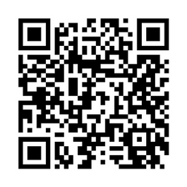


Practical Information
09:00–10:00 | Welcome and registration
10:00–10:30 | Welcome Session
10:30–11:15 | Keynote speech with Manja Klemenčič
11:30–13:00 | Session 1 – Alliances fostering Changemakers
13:00–14:00 | Lunch
14:00–15:30 | Session 2 - Rethinking Higher Education to Respond to Global Challenges
15:45–16:30 | Keynote speech with Liviu Matei
16:30–17:00 | Final remarks & Closing session
QR Code - CircleU. Website Event Programme
Questions? Go to wooclap.com Enter the code: DLXONA
#CircleU2023

Slide 3
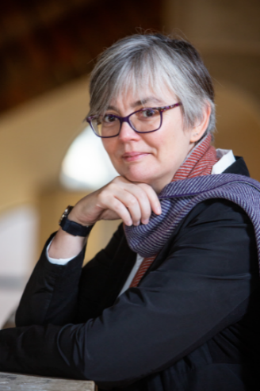
Host
Dana Samson
Pro-rector for international affairs at UCLouvain

Slide 4
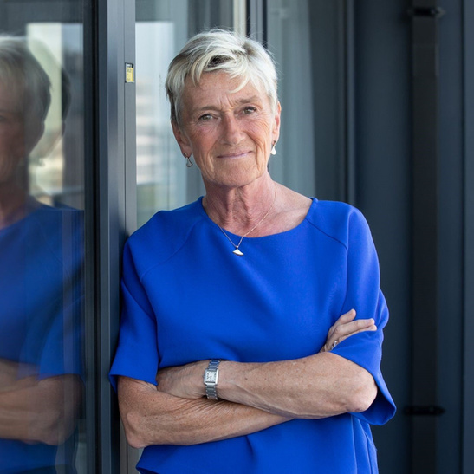
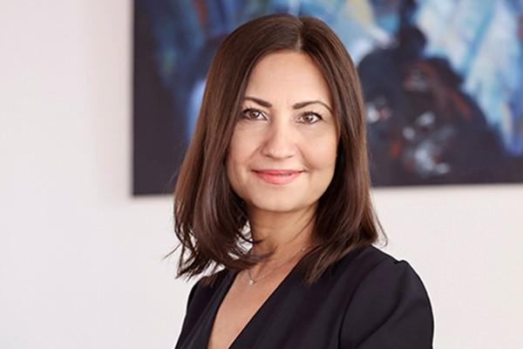
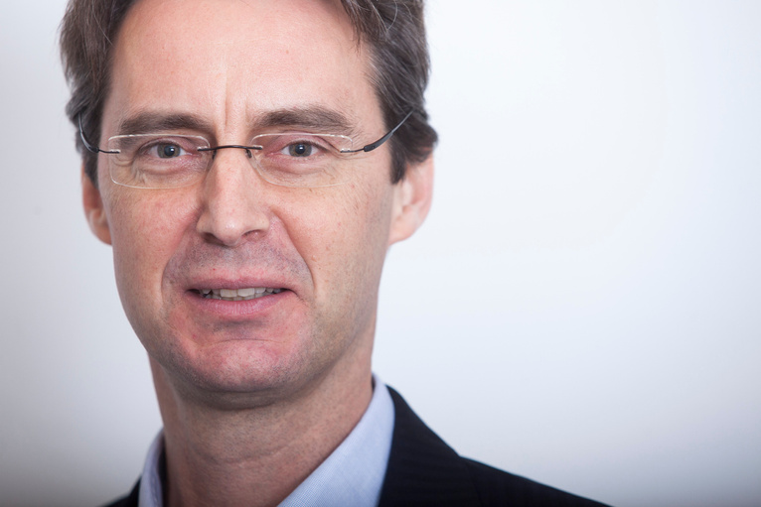
Welcome Session
Françoise Bertieaux
Minister for higher education and research of the Federation Wallonia-Brussels
Iliana Ivanova
European Commissioner for Innovation, Research, Culture, Education and Youth
Vincent Blondel
Rector of UCLouvain

Slide 5
Words from the Commissioner ...

Slide 6
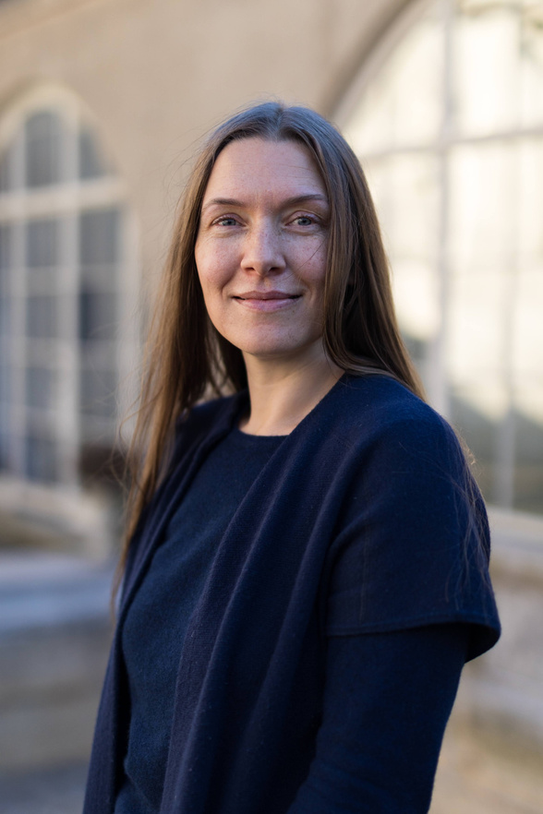
Keynote Speech
Manja Klemenčič
Expert on Sociology of Higher Education, Harvard University/University Ljubljana

Slide 7
Break 15 min.
09:00–10:00 | Welcome and registration
10:00–10:30 | Welcome Session
10:30–11:15 | Keynote speech with Manja Klemenčič
11:30–13:00 | Session 1 – Alliances fostering Changemakers
13:00–14:00 | Lunch
14:00–15:30 | Session 2 - Rethinking Higher Education to Respond to Global Challenges
15:45–16:30 | Keynote speech with Liviu Matei
16:30–17:00 | Final remarks & Closing session
QR Code - CircleU. Website Event Programme
Questions? Go to wooclap.com Enter the code: DLXONA
#CircleU2023

Slide 8
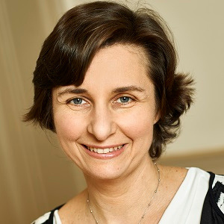
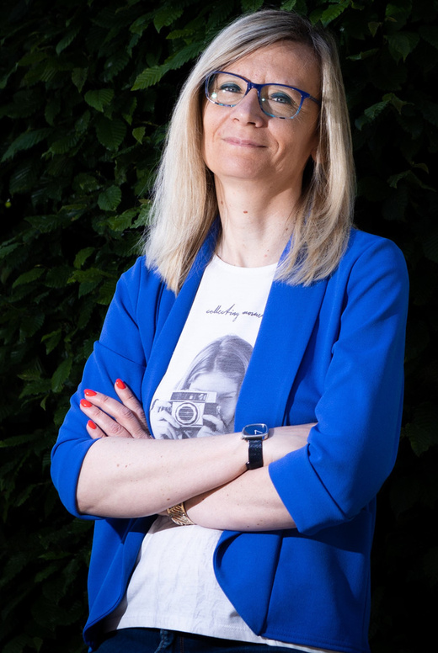
Session 1 – Alliances fostering Changemakers
Questions? Go to wooclap.com Enter the code: DLXONA
Moderated by Christel Vacelet International Office Director UCLouvain
Amélie Jacquemin
Academic chair, Circle U. In.CU.bator platform

Slide 9
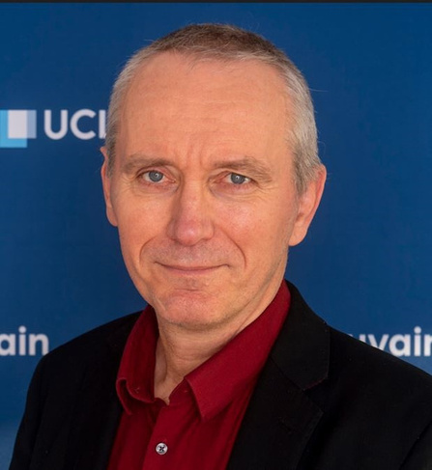
Session 1 – Alliances fostering Changemakers
Questions? Go to wooclap.com Enter the code: DLXONA
Moderated by Christel Vacelet International Office Director, UCLouvain
Marnik Vanclooster
Academic chair, Circle U. Climate Knowledge Hub

Slide 10
Session 1 – Alliances fostering Changemakers
Shaping research and innovation in the Circle U Climate Knowledge Hub
Context
  Climate change (CC) is one of the most important challenges for humanity.
  The scientific evidence of CC, and current and expected future impacts of CC are well documented.
  Adaptation and mitigation is urgently needed, but pathways to make the transition to climate resilient societies are still subjected to large uncertainty.
  Innovation in technology & infrastructure, but also in human agency is needed to successfully reach sustainable societies.

Slide 11
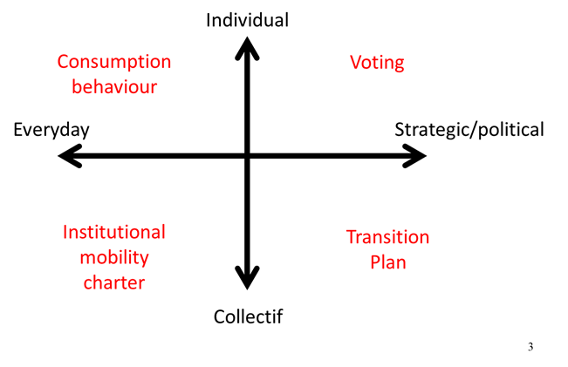
Session 1 – Alliances fostering Changemakers
How humans can build a climate resilient world
Capacity building
Training - education
Research
Innovation

Slide 12
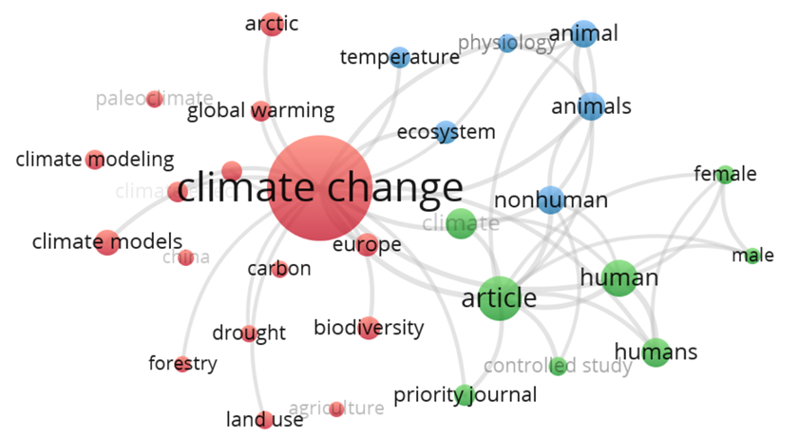
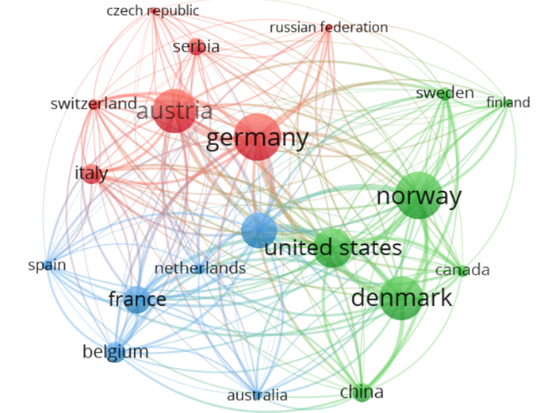
Session 1 – Alliances fostering Changemakers
Mapping potential (experts and expertise)

Slide 13
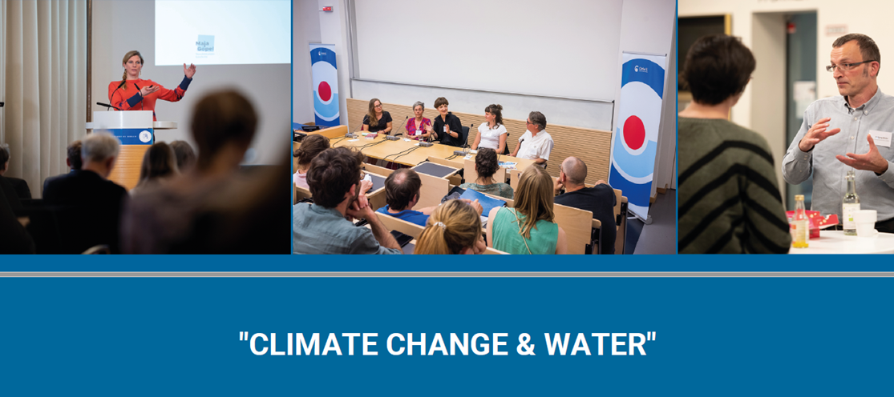
Session 1 – Alliances fostering Changemakers
Gap analysis via thematic workshops

Slide 14
Session 1 – Alliances fostering Changemakers
Shaping innovation
  Joint organisation of summer schools for undergraduate & graduate students
  Joint organisation of specific thematic seminars
  Joint interdisciplinar and transdisciplinar training for profesionnals
  Joint new research project initiatives

Slide 15
Session 1 – Alliances fostering Changemakers
Challenges
  Circle U’s potential is large, but the Circle ecosystem is complex:
  How can Circle U identity be increased for local staff & students?
  How can co-constructed Circle U activities be implemented efficiently?
  How can activities be scaled-up?

Slide 16
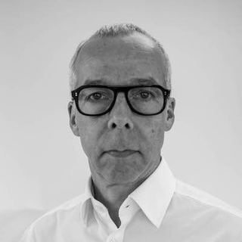
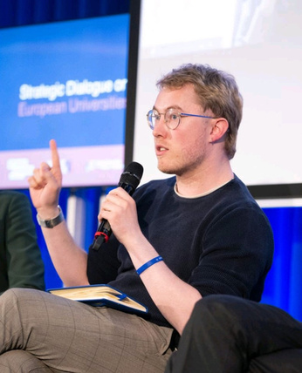
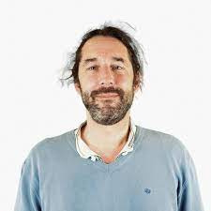
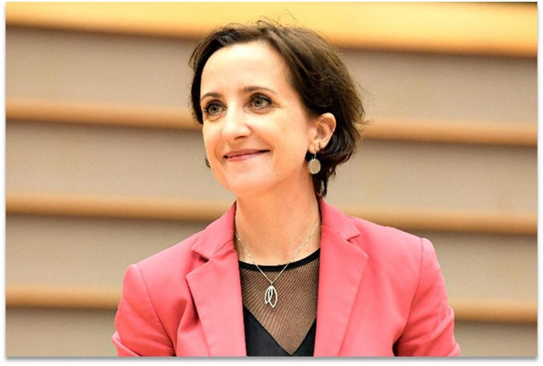
Session 1 – Alliances fostering Changemakers
Moderated by Christel Vacelet
International Office Director, UCLouvain
Questions? Go to wooclap.com Enter the code: DLXONA
François Heinderyckx
Advisor to the ULB Rector on CIVIS and Member of CIVIS Steering Committee
Tanguy Guibert
European Students' Union
Marc Vanholsbeeck Belgian Science Policy Office
Vanessa Debiais-Sainton Directorate-General for Education and Culture

Slide 17
Lunch Break
09:00–10:00 | Welcome and registration
10:00–10:30 | Welcome Session
10:30–11:15 | Keynote speech with Manja Klemenčič
11:30–13:00 | Session 1 – Alliances fostering Changemakers
13:00–14:00 | Lunch
14:00–15:30 | Session 2 - Rethinking Higher Education to Respond to Global Challenges
15:45–16:30 | Keynote speech with Liviu Matei
16:30–17:00 | Final remarks & Closing session
QR Code - CircleU. Website Event Programme
Questions? Go to wooclap.com Enter the code: DLXONA
#CircleU2023

Slide 18
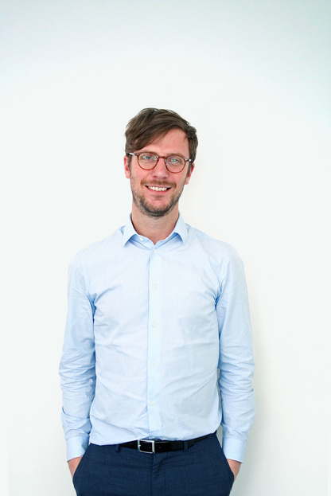
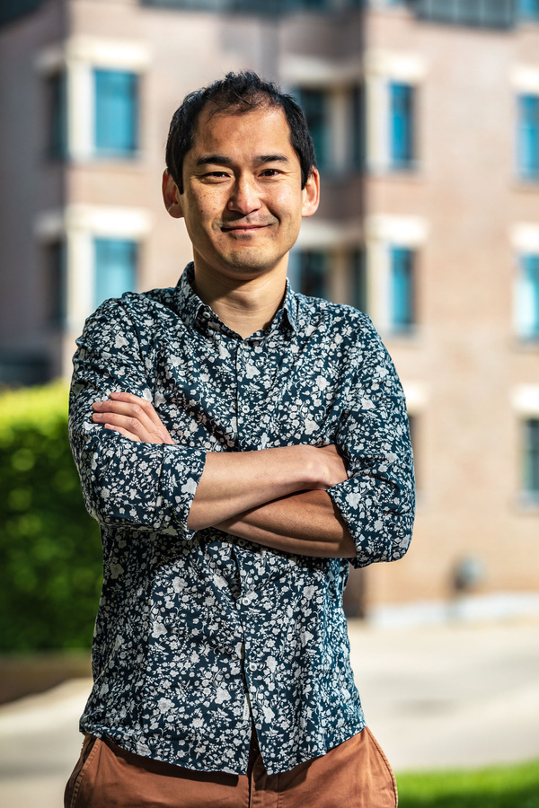
Session 2 – Rethinking Higher Education to Respond to Global Challenges
Questions? Go to wooclap.com Enter the code: DLXONA
Moderated by Kevin Guillaume, Secretary General of Circle U.
Min Reuchamps
Academic chair, Circle U. Teaching Innovation Lab

Slide 19
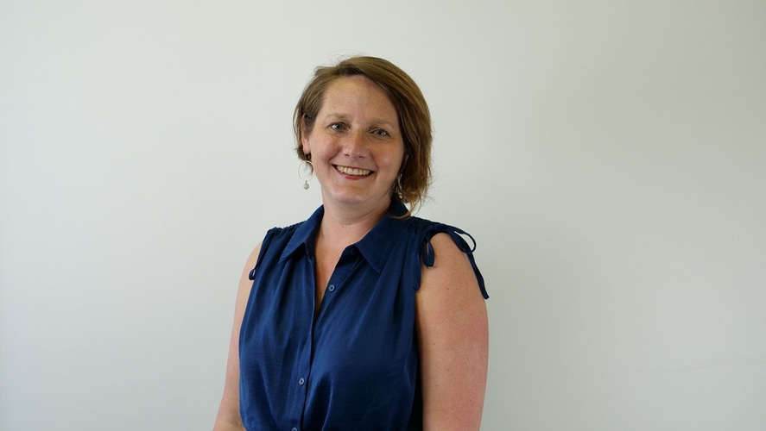
Session 2 – Rethinking Higher Education to Respond to Global Challenges
Moderated by Kevin Guillaume Secretary General of Circle U.
Questions? Go to wooclap.com Enter the code: DLXONA
Sandy Tubeuf
Academic chair, Circle U. Global Health Knowledge Hub

Slide 20
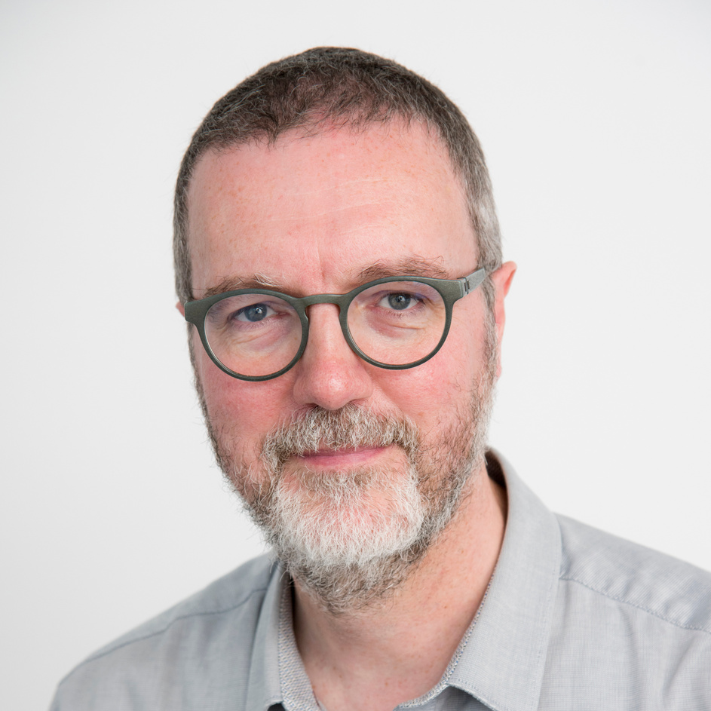
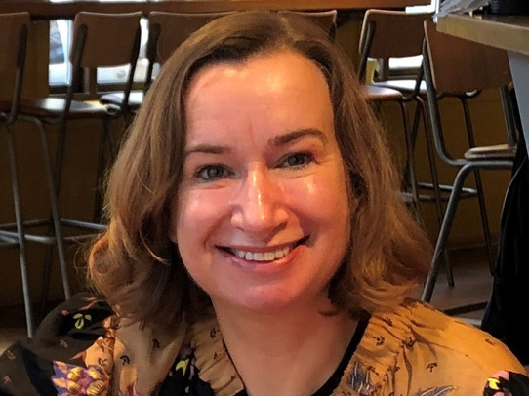
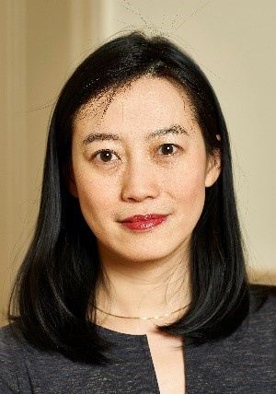
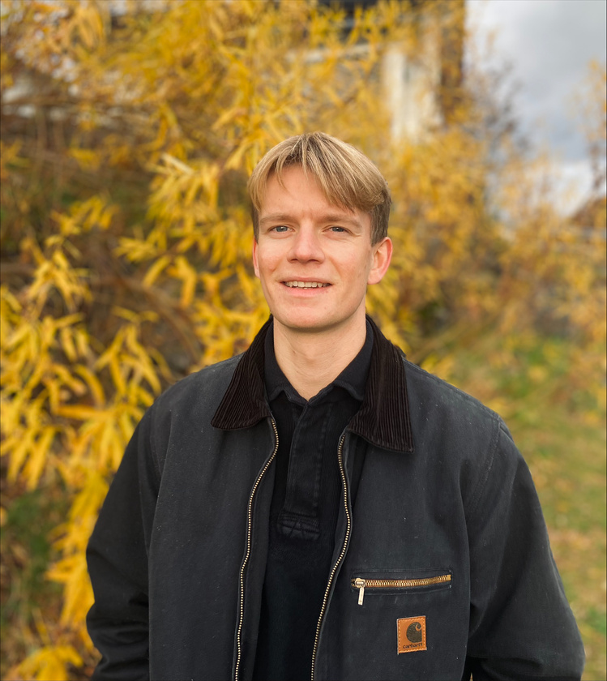
Session 2 – Rethinking Higher Education to Respond to Global Challenges
Moderated by Kevin Guillaume Secretary General of Circle U.
Questions? Go to wooclap.com Enter the code: DLXONA
Karel Van Acker
Chairman of KU Leuven’s Sustainability Council and Member of Una Europa’s Self-Steering Committee on Sustainability
Julie Anderson
Directorate-General for Education and Culture
Thérèse Zhang
European University Association
Erlend D. Aag
Circle U. Student Union Alumnus

Slide 21
Break 15 min.
09:00–10:00 | Welcome and registration
10:00–10:30 | Welcome Session
10:30–11:15 | Keynote speech with Manja Klemenčič
11:30–13:00 | Session 1 – Alliances fostering Changemakers
13:00–14:00 | Lunch
14:00–15:30 | Session 2 - Rethinking Higher Education to Respond to Global Challenges
15:45–16:30 | Keynote speech with Liviu Matei
16:30–17:00 | Final remarks & Closing session
QR Code - CircleU. Website Event Programme
Questions? Go to wooclap.com Enter the code: DLXONA
#CircleU2023

Slide 22
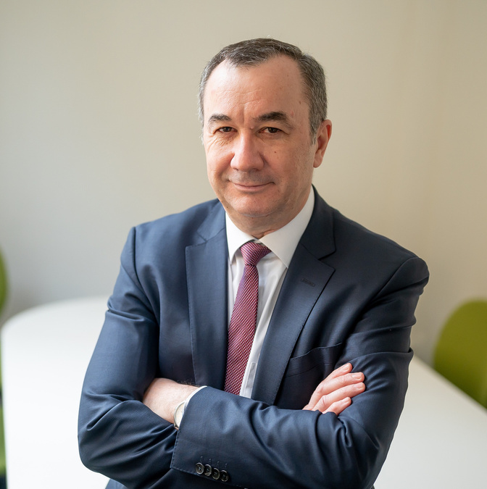
Keynote Speech
Liviu Matei
Head of the King's School of Education, Communication & Society, King’s College London

Slide 23
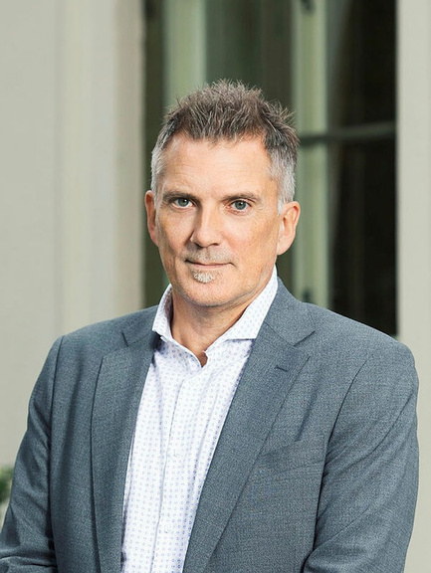
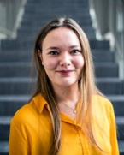
Final remarks & Closing session
Bjørn Stensaker
Vice-Rector for Education, University of Oslo
Chair of the Circle U. Management Board
Puk Willemoes
Circle U. Student Union Alumna

Slide 24




Thank you
Let’s stay in touch
@CircleU_eu
infocircleu@uclouvain.be
engage-with@circle-u.eu
Circle U. (European University Alliance)
https://www.circle-u.eu/

