Slide 1



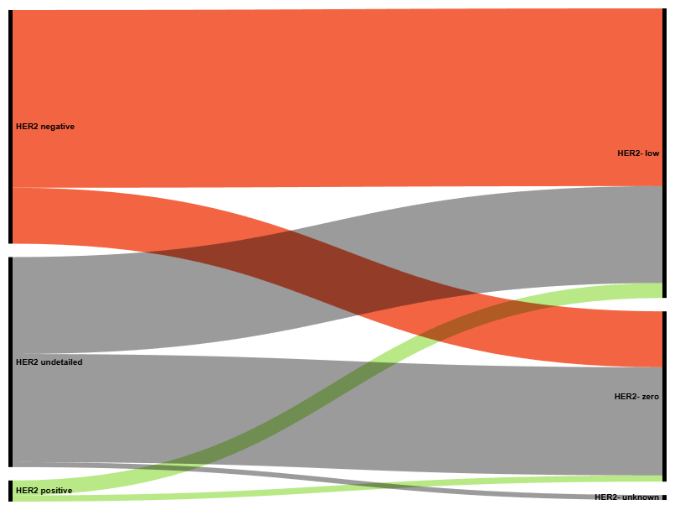



Disease natural history and care quality assessment of hormone receptor positive / human epidermal growth factor receptor 2 negative metastatic breast cancer (HR+/HER2- mBC) – an international multicentric study
S Theophanous¹, L Revie², O Bouissou³, F Duhoux⁴, P Galgane Banduge⁵, A Choudhury⁵, A Collard⁴, W Hai Deng³, G Hall¹, RJ Geukes Foppen⁶, V Gouthamchand⁵, I Kaczmarczyk², E Krasniqi⁶, L Licata⁷,
A Lobo Gomes⁸, L Sanchez Gomez⁹, A van Maanen⁴, G Podevijn⁴, E Ross³, J Thonnard⁴, A Thomas⁴, C Twelves¹, X Fernandez¹⁰, C van Marcke⁴
¹Leeds Teaching Hospitals NHS Trust, United Kingdom. ²IQVIA Ltd, United Kingdom. ³Oslo University Hospital, Norway. ⁴Cliniques Universitaires Saint-Luc, Belgium. ⁵Maastricht University, The Netherlands. ⁶ IFO, IRCCS Ospedale Regina Elena, Italy. ⁷IRCCS Ospedale San Raffaele, Italy. ⁸RWTH Aachen, Germany. ⁹Medical Data Works, The Netherlands. ¹⁰DigiCORE, Belgium.
Background
Patient cohort and results
Despite early detection and treatment, ~ 30% of early-stage HR+ HER2- breast cancer (BC) patients relapse. ^{1,2} Re-biopsy at relapse is recommended and molecular profiling of metastatic sites to determine HER2 status is essential, to detect actionable mutations and to guide treatment selection and sequencing. ^{3,4}
This study aimed to assess natural history, treatments received and outcomes in patients with HR+/HER2- mBC, by metastasis presentation and HER2- status.
The study included a total of 1,387 HR+ HER2- mBC patients with final analysis focusing on
551 patients with deep phenotypic data available.
Of HER2 negative recurrent patients, 5.6% were HER2 positive at early stage BC
HR+ HER2 negative mBC patients (n=551)
Methods
De novo metastasis (n=183)
Metastasis concurrent with primary BC
HER2 negative (n=183 – 185*)
HER2- low (n=233)
Cohorts of HR+ (PR / ER >= 10%) HER2- mBC patients diagnosed between 2018 and 2023 were identified at five European hospitals from their EHR mapped to OMOP common data model.
Sub-cohorts were defined by disease status: (1) ‘De novo’ or (2) ‘recurrent’; and by HER2 status: (i) HER2-low (IHC 1+ or ISH not amplified), or (ii) HER2-zero (IHC = 0 on and prior to metastatic index).
Key oncological variables from the Minimal Essential Description of Cancer (MEDOC) framework extracted clinical data locally.^{5,6}
Recurrent metastasis (n=368)
Relapse from early BC
HER2 status at early BC
HER2- low
IHC 1/2+ / ISH not amplified
HER2- low (n=63)
HER2- zero (n=108)
HER2- undetailed (n=12)
HER2- low (n=233)
HER2- zero (n=131)
HER2- undetailed (n=4)
HER2 undetailed (n=159 – 164*)
HER2 status at mBC
De novo metastasis
Metastasis is concurrent with primary BC
Recurrent metastasis
Patient had prior non metastatic early BC
HER2- zero
IHC = 0 on and prior to metastatic index
HER2- zero (n=131)
Metastatic BC presentation (HR+ / HER2-)
Table 1: Characteristics of mBC HR+ HER2- patients. *Estimated federated median **Mean of range
 |  | De novo metastatic | Recurrent metastatic
Total patients (n) |  | 183 | 368
Age at index (median* – min, max) |  | 65 (25-93) | 64 (27-99)
Disease stage at initial BC diagnosis (n, %) | I | N/A | 64 (17.3%)
 | II |  | 175 (47.6%)
 | III |  | 74 (20.1%)
 | IV |  | 1** (0.3%)
 | Unknown / Missing |  | 54 (14.7%)
HER2 positive (n=12 – 17*)
HER2- undetailed (n=4)
Figure 1: HER2 status concordance for recurrent mBC patients *indicates federated range count
Future directions and conclusions
Changes in HER2 status between primary and metastatic disease highlight the clinical requirement for re-biopsy at relapse.
More than 50% of the HER2- mBC patients carried an actionable gene mutation, indicating they could benefit from targeted therapy.
Future analyses will evaluate the sequencing and clinical outcomes of therapies in molecular phenotype and mutation subgroups, and assess clinical characteristics of patients who are rebiopsied.
Clinical and demographic
Biomarkers
HER2 status
Re-biopsy
Care quality
Age at index, sex, primary dx date, time to metastasis, CCI, performance status,
metastasis location
Test at metastatic index date for: BRCA1/2, CDH1, PALB2, PTEN, TP53, PIK3CA, AKT, ERBB2, ESR1
HER2 status at metastatic dx, HER2 status at early BC dx
Rebiopsy at metastatic dx, rebiopsy timepoint, ER/PR status at metastatic and early BC dx
Treatment type (CDK4/6i, targeted, endocrine therapy), chemotherapy, radiotherapy, surgery, time to treatment
**Mean of range is presented where small number suppression occurs at 1 or more centres during federated analysis
Data extracts were analysed using the Vantage6 federated learning platform. Through federated learning, no individual level patient data were shared across centres, returning aggregated summary statistics.
For patients who underwent genomic testing, 16.8% carried a germline BRCA1 or BRCA2, 50% carried a somatic PIK3CA, 4% carried a somatic AKT1 and 4% carried a somatic ERBB2 mutation.
References
1 Co M., Ng J., Kwong A. De-novo metastatic breast cancers with or without primary tumor resection - A 10-year study. Cancer Treat Res Commun. 2019;19:100118.
2 Redig A. J., McAllister S. S. Breast cancer as a systemic disease: a view of metastasis. Journal of Internal Medicine. 2013;274(2):113-26.
3 Gennari A., Andre F., Barrios C. H., Cortes J., de Azambuja E., DeMichele A., et al. ESMO Clinical Practice Guideline for the diagnosis, staging and treatment of patients with metastatic breast cancer. Ann Oncol. 2021;32(12):1475-95.
4 Andre Fabrice, Filleron Thomas, Kamal Maud, Mosele Fernanda, Arnedos Monica, Dalenc Florence, et al. Genomics to select treatment for patients with metastatic breast cancer. Nature. 2022;610(7931):343-8.
5 Ajmal, A., Bouissou, O., Brash, J., Cheeseman, S., Banduge, P.G., Gomes, A.L., Revie, L., Ross, E., Theophanous, S., Thonnard, J. and Van Maanen, A., 2025. Establishing standards: harmonising coding principles for a minimal cancer dataset in the OMOP Common Data Model. ESMO Real World Data and Digital Oncology, 9, p.100179.
6 Traverso, A., Mahon, P., Fernandez, X., Pahlavan, G. and Tonon, G., 2025. Abstract B060: DIGIONE: From Fragmentation to Federation: Enabling Scalable Oncology RWE (Real World Evidence) through an international hospital based Cancer OMOP (Observational Medical Outcomes Partnership) Network. Clinical Cancer Research, 31(13_Supplement), pp.B060-B060.
7 Moncada-Torres A., Martin F., Sieswerda M., Van Soest J., Geleijnse G. VANTAGE6: an open source priVAcy preserviNg federaTed leArninGinfrastructurE for Secure Insight eXchange. AMIA Annu Symp Proc. 2020;2020:870-7.

