Slide 1
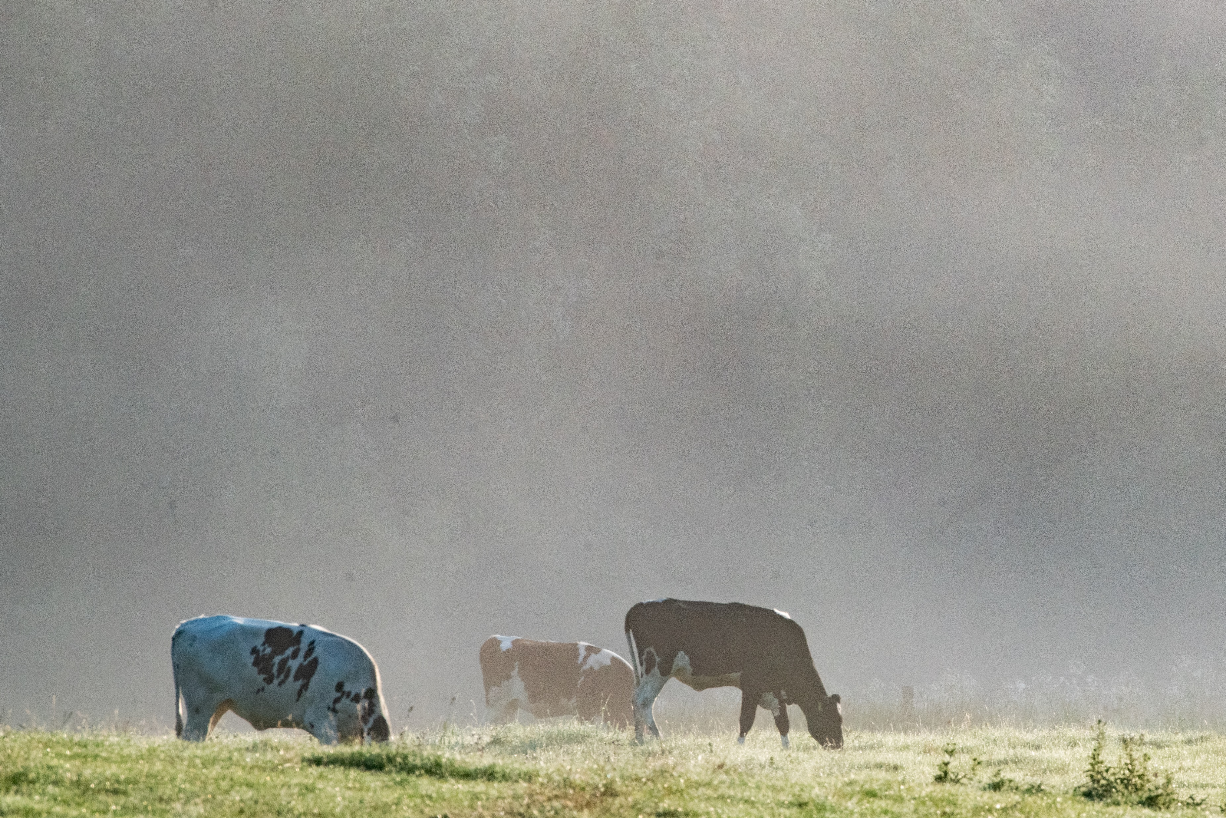


Economic implications of a protein transition:
Evidence from Walloon beef and dairy farms
January 25th 2023, LEAP conference
Océane Duluins (Presenter)
Goedele Van den Broeck and Philippe Baret
Paper co-authors: Monica Schuster and Anton Riera
Photograph by Philippe Baret
Notes:
The farm to fork strategy, aimed at accelerating the transition to a sustainable food system, emphasizes a transition towards more plant-based diets. This transition, also called the protein transition, may however affect current livestock farmers. My name is Oceane, and I am currently a PhD student at UCLouvain. Today I’d like to share the results published in Frontiers in Sustainable food systems on the economic implications of a protein transition on Walloon beef and dairy farms.

Slide 2

Livestock production is confronted with major challenges
Environmental issues
Feed
GHG
Key ecosystem services
Health issues
Biomass conversion
Processed meat
Water and air pollution
Animal welfare issues
Antibiotics use
Carbon storage
Landscape and biodiversity
Red meat
Soil fertility
Abuses in slaughterhouses
Notes:
Livestock production is confronted with major challenges including environmental issues such as GHG emissions, water, and air pollution but also indirect effects arising from the production of feed crops such as soy. Processed and red meat overconsumption have also been associated to obesity and non-communicable disease. And finally, animal welfare issues include, among others, the abusive use of antibiotics and abuses in slaughterhouses. However, well managed crop and livestock systems also provide key ecosystem services including the conversion of non-edible biomass into nutritious food for human consumption, carbon storage, preserving landscapes and biodiversity through the maintenance of grasslands and the contribution to soil fertility through manure nitrogen going back to the soil.

Slide 3






The protein transition as a solution?
Protein transition :
Rebalancing of protein consumption between animal and alternative proteins
→ Better for the environment, for health and animal welfare
Notes:
In this context, the protein transition is more and more presented as a solution to tackle these issues. The protein transition can be defined as a rebalancing of protein consumption between animal and alternative proteins. In countries where animal protein consumption greatly exceeds the dietary guidelines, the protein transition is seen as better option for the environment, for health , and also for animal welfare.

Slide 4

The Walloon context
5,000 dairy farms
6,500 beef farms
Diversity of livestock production systems:
Feed and grazing practices
Land size, etc.
Economic precarity of some farmers
Dependence on feed imports
48% of farms
1,1 million cattle
Photograph by Philippe Baret
Notes:
The Walloon region is well-specialized in milk (dairy farms) and meat (beef farms) production. There are around 5,000 dairy farms and 6,500 beef farms for a total of 1.1 million cattle population. And 48% of farms in Wallonia are specialized in livestock production. Both sectors exhibit a large diversity of production systems, differing in the herd and land size but also in grazing and feeding practices. While contributing to about 60% of the Belgian agricultural value, some farmers face serious economic precarity. And last but not least, the dairy sector, and to a lesser extent the beef sector, rely on imported feed, such as soy, traded on international markets and related to indirect and direct deforestation

Slide 5

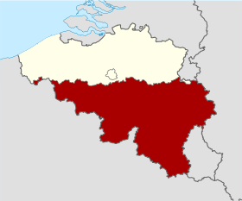

Livestock production systems are embedded in a multi-level system
Macro-level
e.g. Europe
European context
Meso-level
e.g. Belgium
Livestock sector
Production systems
Micro-level
e.g. Farms
Notes:
Livestock production systems are not isolated but are part of a multi-scale system.
On the micro level, we find the is the economic reality of breeders and their production system - based on the allocation of different production factors.
The meso level corresponds to the level of the region or country. This level gives stability to the dominant socio-technical system, composed of several dominant sectors.
On the macro level, the international and European contexts also influence the meso and micro levels. This for example the case of the common agricultural policy and subsidies which influence the meso and micro levels.

Slide 6
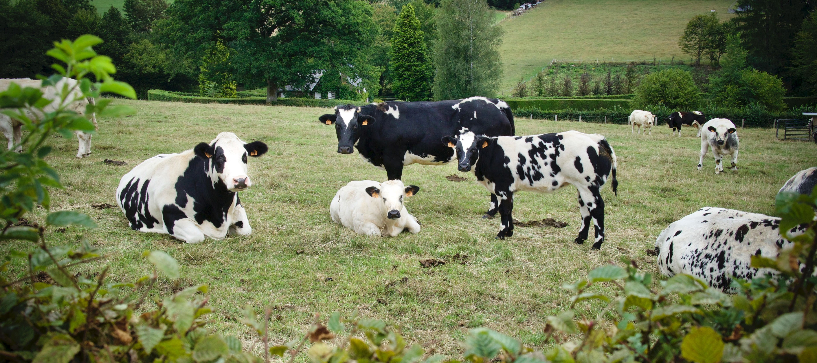
Research questions
How will the protein transition impact the economic performance of Walloon beef and dairy farms ?
Will the two sectors be impacted in the same way?
→ Accounting for diversity
Source : De Vylder, Unsplash (2022)
Notes:
In this study, we provide micro-economic evidence of the impacts of the protein transition on Walloon beef and dairy farms and we focus on two research questions. First: how will the protein transition impact the economic performance of Walloon beef and dairy farms? Second, will the two sectors be impacted in the same way? One of our objective and major attention point was also to account for the diversity that can be observed at the micro-level regarding the different production systems that exist.

Slide 7
Three factors associated with a protein transition
Protein transition
DEPENDENT VARIABLES
Economic indicators
INDEPENDENT VARIABLES
Milk productivity (L/cow)
Gross revenues (€/ha)
Operating costs (€/ha)
Operating profits (€/ha)
Subsidies (€/ha)
Etc.
Transition-related factors
Herd size (LSU)
Share of grassland (%)
Concentrate self-sufficiency (%)
Feed self-sufficiency
Notes:
We focused on three main parameters associated with a protein transition:
The first parameter is herd size. We believe that the protein transition might affect the size of the total herd (at the regional scale) but also herd sizes at the farm level. Herd size can be adjusted according to different criteria, including, for example, feed self-sufficiency (farm or regional level), a production adapted to Belgian consumption on the basis of dietary guidelines (regional or national level), etc.
The second parameter is the share of grassland. This parameter is relevant in the Walloon context since grazing remains the usual management practice in Wallonia. The share of grassland contributes to what can be called “on-farm feed self-sufficiency” which is not directly assessed in this article but is approximated with the share of grassland and the concentrate feed self-sufficiency
The last parameter of interest is the use of concentrates and in particular concentrate self-sufficiency. Concentrates are particularly interesting because they are composed of co-products, including imported soybeans and soybean meals. Furthermore, the use of concentrates reflects a certain intensification of the system. Farms with a higher use of concentrate tend to be farms with a higher impact on the environment.
In this study, we evaluated how these factors affect the economic performance of the farm : for example : is a lower herd size associated with lower revenues? Or is a higher share of grassland associated with lower operating costs? We analyse different economic indicators to disentangle cost-reducing and revenue-enhancing effects: milk productivity, gross revenues, operating costs etc. Finally we analyse to what extent these factors are associated with an increase in the share of subsidies in income..

Slide 8
Data and methods
Database: Farm Accountancy Data Network (FADN)
Specialized dairy (OTE450) and beef farms (OTE460)
Panel data: 2014-2017 (Unbalanced pool)
Number of observations:
  Beef sector: 208 – 65 farms
  Dairy sector: 324 – 95 farms
Data analysis: Random model effects
Model estimated: Y_{it} = α + β X_{it} + θ_{t} + υ_{t} + a_{i} + u_{it}
Notes:
1) Our assessment is based on the European FADN database, which provides harmonized microeconomics indicators at the farm level.
2) Our focus was on specialized dairy and beef farms. In order to be classified as specialized dairy farms, at least 2/3 of the farm’s standard gross product (SGP) must come from the dairy business.
3) We used a panel data with 4 years of observation. We had an unbalanced panel: meaning that some farms were represented 4 times but others only 1, 2 or 3 times.
4) So in total, we had 208 observations corresponding to 65 farms for the beef sector and 324 observations for the dairy sector with 95 farms.
5) We used a random model effect to associated economic parameters to dependent variables (including our 3 parameters of interest)

Slide 9
Dairy farms are more profitable and less subsidy-reliant
 |  |  | Dairy sector | Beef sector | Sector comparison
Number of observations |  |  | N = 324 | N = 208
Name |  | Unit | Mean | Mean | Two-sided p-value
Milk productivity |  | L/cow | 6,322 | / | /
Gross revenues/ha | a | €/ha | 2,918 | 1,810 | ***
Operating expenses/ha | b | €/ha | 1,319 | 1,061 | **
Operating profits/ha | c = a-b | €/ha | 1,599 | 748 | ***
Operating profit margin | c/a | % | 55 | 42 | ***
Subsidies/ha |  | €/ha | 402 | 600 | ***
Subsidy dependence | Subsidies/Gross revenues | % | 13 | 28 | ***
Significant differences tested using two-sided t-tests: p<0.1*; p<0.05**; p<0.01***
Notes:
This table presents summary statistics of dependent variables for the two sectors per hectare. Means for both sector are presented and a sector comparison is made by performing t-tests on the mean value. Almost each economic indicators are statistically different at 1%. In general, all economic variables are higher for the dairy sector compared to the beef sector. The dairy sector is performing better in terms of gross revenues, operating profits, operating profit margin (*operating profits/gross revenues). In addition, this sector is less dependent on subsidies. We have two indicators for subsidies: subsides per hectare and subsidy dependence. We can see that subisdies per hectare and subsidy dependence are lower for the dairy sector.

Slide 10
Dairy farms rely more on the use of concentrates
 |  | Dairy sector | Beef sector | Sector comparison
Number of observations |  | N = 324 | N = 208
Name | Units | Mean | Mean | Two-sided p-value
Herd size | LSU | 121.40 | 147.43 | ***
Grazing livestock density | LSU/SFL | 1.96 | 2.23 | ***
Cattle area | Ha | 64.73 | 68.64
Share of grassland | % | 84.37 | 88.07 | **
Concentrate total | Kg/year/farm | 122,581 | 73,620 | ***
Concentrate autonomy | % | 6.00 | 18.78 | ***
Labour | Annual work unit | 13.54 | 27.56 | ***
Significant differences tested using two-sided t-tests: p<0.1*; p<0.05**; p<0.01***
Notes:
Moving on to independent variables. The beef sector presents larger herd sizes with an average of 147 cows, compared to 121 cows for the dairy sector and a higher grazing livestock density with 2.23 livestock units per hectare of fodder area compared to 1.96 for the dairy sector.
Regarding concentrates, the dairy sector has a higher total concentrate use with one hundred and twenty-two thousand kilograms per year compared to seventy thousand for the beef sector. And the concentrate autonomy, which is the ratio between concentrate produced on farm over total concentrate use, is higher for the beef sector than the dairy sector.

Slide 11
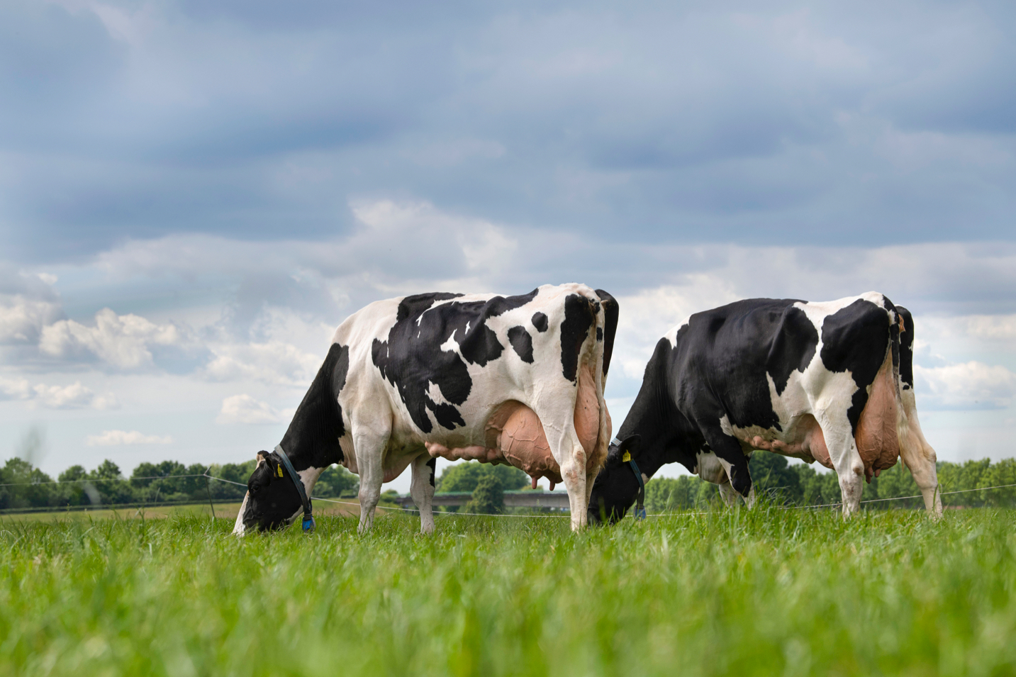
Source: Mindy (Hotline)
Notes:
Let’s now focus on the results of the random model for the dairy sector

Slide 12

Dairy sector
Gross revenues
Operating expenses
Operating profits
Operating profit margin
a
b
c = a-b
d = c/a
Herd size
Share of grassland
Concentrate self-sufficiency
Arrows represent a statistically significant correlation at 1% or 5%.
1) Operating profit margin is indifferent to herd size
2) Extensive grazing systems providing environmental services and economic benefits
Notes:
I will present the results by focusing on the three independent variables that we think could be impacted in the context of a protein transition. As a reminder, operating profits are defined as the difference between gross revenues and operating expenses while operating profit margin is operating profits divided by gross revenues. Operating profit margin is a profitability or performance ratio. Finally color is used to describe if the farmer is better or worse off. The green indicates that the farmer is better off while red indicates that the farmer is worse off.
For the dairy sector, we find an increase in herd size is associated with higher gross revenues but also higher operating costs, leading to higher operating profits but no differences in operating profit margins. Farms with a higher share of grassland and an increased concentrate feed self-sufficiency have a lower milk productivity and therefore lower gross revenues, but their operating costs are lower, resulting in higher operating profit margins and no significant differences of operating profits.
The results suggest that operating profit margin is indifferent to herd size and that switch to more extensive grazing systems can entail some economic benefits or at least no economic penalty for farmers

Slide 13
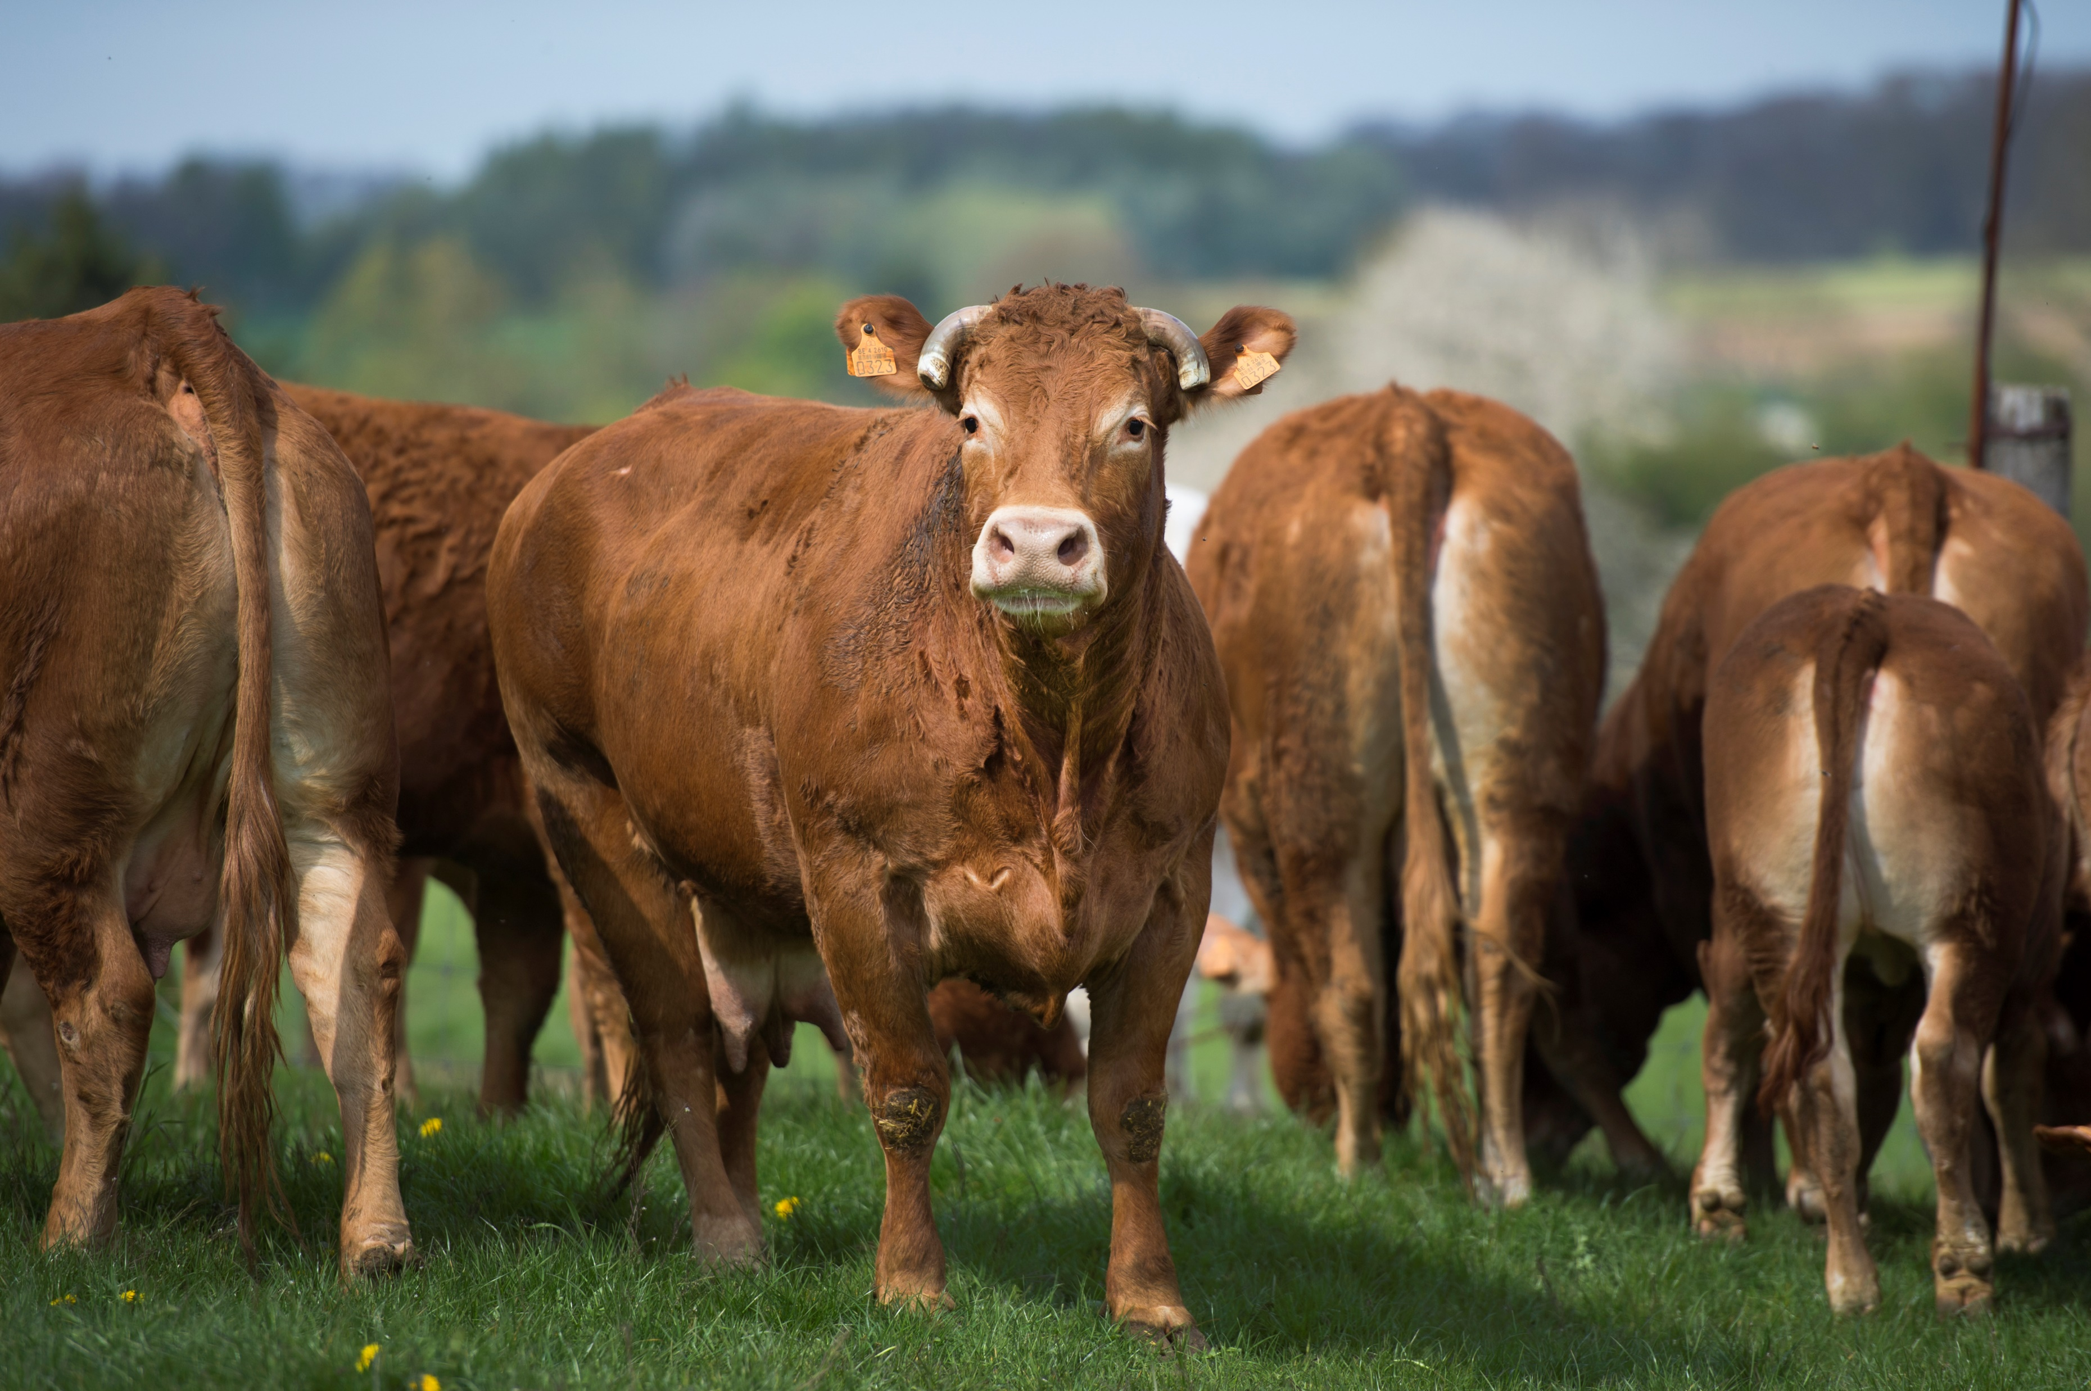
Photograph by Philippe Baret
Notes:
Moving on to the beef sector results

Slide 14
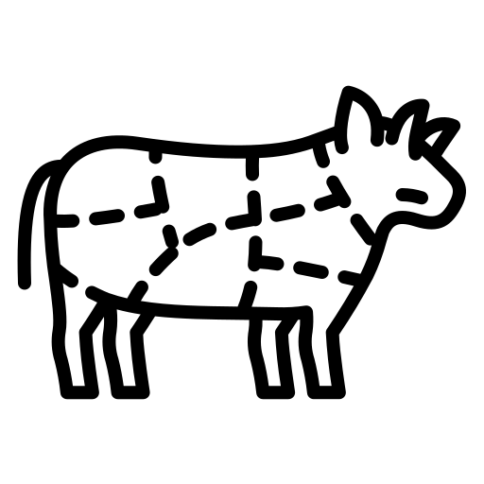
Beef sector
Most economic indicators are not dependent on farms characteristics
But subsidies are
  Grazing livestock density and the size of the farm positively correlated to subsidies per hectare and subsidy dependence
Without subsidies, farmers are facing economic losses
→ Business model based on subsidies rather than on actual market supply and demand factors
Notes:
In the beef sector, on the other hand, we saw that most economic indicators were not correlated to farm characteristics. However, subsidies were highly correlated with farm characteristics. In particular, a higher grazing livestock density and a higher size of the farm was positively correlated to subsidies per hectare and subsidy dependence.
The results allowed us to show that without subsidies, farmers are facing economic losses. This reliance on subsidies from the CAP has been found in other studies, and suggests that changes in this sector will rather be induced by changes to the CAP subsidies than by economic parameters. The business model of beef farms is rather based on subsidies than on actual market supply and demand factors.
Gross revenues/unit of labour = -17 750 euros/annual work unit with 23,000 euros of subsidies per AWU

Slide 15
Conclusions
The economic implications of the protein transition are very different depending on the sector.
Policy implications:
Dairy sector: support to more autonomous production systems based on-farm fodder production
Beef sector: how to gear a protein transition in which breeders are not left behind ?
Notes:
Going back to our research questions, our study shows that the implications of a protein transition will be different according to the sector. Our results allow us to promote more autonomous production systems based on grass as the main forage in the dairy sector while in the beef sector, more research is needed on how to gear a protein transition in which farmers are not left behind.

Slide 16

Thank you for your attention !
Article available in Frontiers in Sustainable Food Systems
For further information: oceane.duluins@uclouvain.be
Complementary presentation by Riera Anton this afternoon
Notes:
Thank you for your attention, feel free to use the QR if you are further interested in the study

Slide 17
Agenda
Diversity assessment: Identify typologies of production systems
Sustainability assessment: Determine the most sustainable production systems
Including environmental, social, and economic indicators
3) Focus on economic performance
Notes:
Présenter l’agenda (ici je présente l’agenda des deux articles joints mais faut-il ouvrir d’avantage le scope?)
Identify typologies that go further than the dualization: organic/conventional or conventional/pasture based systems

Slide 18
Two complementary studies
Sustainability assessment of a diversity of production systems
Diversity assessment
Sustainability assessment
Focus on economic performance
THIS AFTERNOON
Economic analysis of the protein transition on the micro-scale level of the farm
THIS PRESENTATION
Notes:
Présenter l’agenda (ici je présente l’agenda des deux articles joints mais faut-il ouvrir d’avantage le scope?)
Identify typologies that go further than the dualization: organic/conventional or conventional/pasture based systems

Slide 19
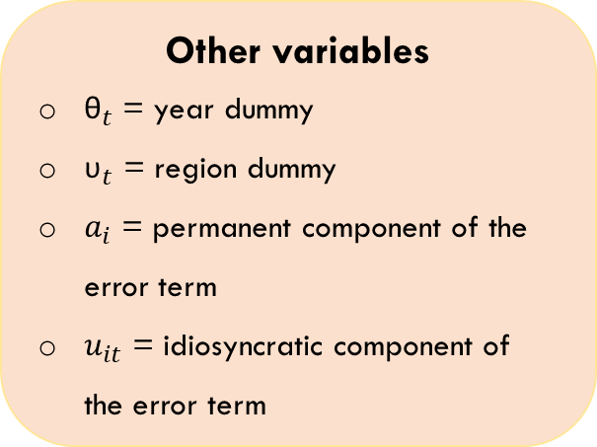
Random model effects
Model estimated: Y_{it} = α + β X_{it} + θ_{t} + υ_{t} + a_{i} + u_{it}
Outcome variables Y :
Milk productivity (log),
Gross revenues per ha (log),
Operating expenses per ha (log),
Operating profits per ha (log),
Operating profit margin,
Subsidies per ha (log) ,
Subsidy dependence
Control variables X :
Herd size (log),
Grazing livestock density,
Cattle area (log),
Share of grassland,
Total concentrate use (log),
Concentrate autonomy,
Total work units (log).
Other variables
${\text{θ}}_{t}$ = year dummy
${\text{υ}}_{t}$ = region dummy
$a_{i}$ = permanent component of the error term
$u_{it}$ = idiosyncratic component of the error term
Notes:
Here is more detail on the model estimated and the different variables of interest. Outcome variables include milk productivity, gross revenues per hectare, operational expenses per hectare, operating profits, operating profit margin, subsidies per hectare and subsidy dependence.
Some variables are expressed in logarithmic values to obtain a normal distribution and hence improve the model fit, and to interpret the results as elasticities.

Slide 20
Dairy sector
 | Milk productivity | Gross revenues/ha | Operating expenses/ha | Operating profits/ha | Operating profit margin | Subsidies/ha | Subsidy dependence
Log (herd size) | 0.16 (0.22) | 1.09*** (0.26) | 0.81*** (0.27) | 1.43*** (0.34) | 11.34 (8.68) | -0.45 (0.29) | -27.62*** (7.37)
Grazing livestock density | -0.01 (0.07) | -0.13 (0.12) | 0.06 (0.12) | -0.29* (0.15) | -9.71*** (3.60) | 0.23 (0.15) | 7.43** (3.04)
Log (cattle area) | -0.04 (0.23) | -0.91*** (0.26) | -0.61** (0.27) | -1.23*** (0.35) | -12.16 (9.08) | 0.20 (0.29) | 22.09*** (7.12)
Share of grassland | -0.004*** (0.002) | -0.004* (0.002) | -0.008*** (0.002) | 0.003 (0.003) | 0.17** (0.08) | 0.000 (0.002) | 0.06 (0.04)
Log (total concentrate) | 0.01 (0.004) | 0.01 (0.01) | 0.02* (0.01) | 0.01 (0.01) | -0.510 (0.404) | -0.005 (0.004) | -0.268 (0.221)
Concentrate autonomy | -0.004* (0.002) | 0.00 (0.002) | -0.003* (0.002) | 0.004* (0.002) | 0.12** (0.05) | 0.003 (0.002) | 0.05 (0.07)

Slide 21
Beef sector
 | Gross revenues/ha | Operating expenses/ha | Operating profits/ha | Operating profit margin | Subsidies/ha | Subsidy dependence
Log (herd size) | 0.67 (0.65) | 0.74 (0.65) | -0.23 (1.16) | 4.52 (16.31) | -0.91 (0.63) | -30.75*** (4.93)
Grazing livestock density | 0.28 (0.34) | 0.26 (0.34) | 0.83 (0.62) | 0.054 (7.54) | 0.65** (0.31) | 6.79*** (0.02)
Log (cattle area) | 0.22 (0.67) | 0.15 (0.67) | 1.45 (1.41) | -1.15 (16.12) | 1.84*** (0.63) | 28.31*** (5.60)
Share of grassland | -0.01* (0.006) | -0.015** (0.007) | 0.006 (0.012) | 0.32 (0.19) | -0.005 (0.005) | 0.12* (0.07)
Log (total concentrate) | 0.02 (0.01) | 0.05** (0.01) | -0.02 (0.01) | -1.56*** (0.28) | -0.02 (0.02) | -0.53 (0.44)
Concentrate autonomy | -0.001 (0.005) | -0.002 (0.003) | 0.004 (0.004) | 0.09* (0.05) | -0.003 (0.002) | -0.04 (0.03)

Slide 22
More information
Subsidies in 2020:
€4.24 billion of subsidies to couple support, of which 40% is dedicated to the beef sector, 21% to dairy sector
Econometric details:
We tested for multicollinearity.
Standard robust errors → heteroscedasticity and auto-correlation
Interaction terms tested: herd size*share of grassland ; herd size*concentrate autonomy ; herd size*cattle area ; etc.

Slide 23
Dairy sector: results per cow
 | Milk productivity | Gross revenues/cow | Operating expenses/cow | Operating profits/cow | Operating profit margin | Subsidy/cow | Subsidy dependence
Log (herd size) | 0.16 (0.22) | 0.07 (0.21) | -0.17 (0.246) | 0.43 (0.31) | 11.34 (8.68) | -1.47*** (0.34) | -27.62*** (7.37)
Grazing livestock density | -0.005 (0.07) | -0.04 (0.08) | 0.16* (0.09) | -0.22 (0.14) | -9.71*** (3.60) | 0.32* (0.17) | 7.43** (3.04)
Log (cattle area) | -0.04 (0.23) | 0.01 (0.22) | 0.29 (0.27) | -0.32 (0.35) | -12.16 (9.08) | 1.13*** (0.35) | 22.09*** (7.12)
Share of grassland | -0.004*** (0.002) | -0.003 (0.002) | -0.006** (0.003) | 0.002 (0.003) | 0.17** (0.08) | 0.001 (0.002) | 0.06 (0.03)
Log (total concentrate) | 0.007 (0.004) | 0.01* (0.007) | 0.02** (0.01) | 0.01 (0.009) | -0.510 (0.404) | -0.002 (0.007) | -0.268 (0.221)
Concentrate autonomy | -0.004* (0.002) | -0.002 (0.002) | -0.005*** (0.002) | 0.002 (0.002) | 0.12** (0.05) | 0.001 (0.002) | 0.05 (0.07)
Log (labour) | 0.05 (0.03) | 0.04 (0.05) | 0.05 (0.06) | 0.02 (0.12) | 1.12 (2.87) | 0.13* (0.07) | 2.11* (1.24)
Constant | 8.32*** (0.28) | 8.84*** (0.38) | 6.75*** (0.53) | 6.89*** (0.63) | 63.12*** (14.71) | 7.73 (0.38) | 36.17*** (5.57)
R² overall | 0.137 | 0.273 | 0.349 | 0.205 | 0.316 | 0.603 | 0.562
***, **, * denote statistical significance at the 1, 5, and 10 percent levels, respectively. Robust standard errors are reported between parentheses. Milk productivity, gross revenues, operating expenses, operating profits and subsidies are expressed in logarithmic values. Seven region dummies are included (Sablo-limoneuse, Condroz, Herbagère, Ardenne, Ardenne, Jura, Famenne), with Limoneuse as base level. Three year dummies are included for 2015, 2016 and 2017, with 2014 as base level.

Slide 24
Dairy sector: results per unit of labor
 | Milk productivity | Gross revenues/labour | Operating expenses/labour | Operating profits/labour | Operating profit margin | Subsidy/labour | Subsidy dependence
Log (herd size) | 0.16 (0.22) | 1.30 (0.95) | 0.49 (0.32) | 1.08*** (0.35) | 11.34 (8.68) | -0.57* (0.30) | -27.62*** (7.37)
Grazing livestock density | -0.005 (0.07) | -0.28 (0.55) | 0.29** (0.13) | -0.04 (0.17) | -9.71*** (3.60) | 0.35** (0.15) | 7.43** (3.04)
Log (cattle area) | -0.04 (0.23) | -0.34 (0.98) | 0.58* (0.31) | -0.001 (0.39) | -12.16 (9.08) | 1.19*** (0.32) | 22.09*** (7.12)
Share of grassland | -0.004*** (0.002) | 0.007 (0.008) | -0.006** (0.003) | 0.001 (0.003) | 0.17** (0.08) | 0.001 (0.002) | 0.06 (0.04)
Log (total concentrate) | 0.007 (0.004) | 0.04 (0.03) | 0.02** (0.01) | 0.01 (0.011) | -0.510 (0.404) | -0.005 (0.005) | -0.268 (0.221)
Concentrate autonomy | -0.004* (0.002) | -0.001 (0.006) | -0.006*** (0.002) | 0.001 (0.002) | 0.12** (0.05) | 0.00 (0.003) | 0.05 (0.07)
Log (labour) | 0.05 (0.03) | -0.70** (0.33) | -0.84*** (0.09) | -0.92*** (0.11) | 1.12 (2.87) | -0.87*** (0.05) | 2.11* (1.24)
Constant | 8.32*** (0.28) | 5.60*** (1.34) | 6.40*** (0.56) | 6.41*** (0.58) | 0.63*** (0.15) | 7.41*** (0.35) | 0.36*** (0.06)
R² overall | 0.137 | 0.284 | 0.690 | 0.516 | 0.316 | 0.600 | 0.562

Slide 25
Beef sector: results per cow
 | Gross revenues/cow | Operating expenses/cow | Operating profits/cow | Operating profit margin | Subsidy/cow | Subsidy dependence
Log (herd size) | 0.17 (0.29) | -0.19 (0.27) | 0.34 (0.86) | 4.52 (16.31) | -1.10*** (0.23) | -30.75*** (4.93)
Grazing livestock density | 0.01 (0.14) | 0.12 (0.12) | 0.08 (0.41) | 0.054 (7.740) | 0.24** (0.12) | 6.69*** (2.26)
Log (cattle area) | -0.11 (0.30) | 0.20 (0.27) | -0.21 (0.82) | -1.15 (16.12) | 1.04*** (0.24) | 28.31*** (5.60)
Share of grassland | -0.005* (0.003) | -0.010*** (0.002) | 0.007 (0.009) | 0.32 (0.19) | 0.001 (0.003) | 0.12* (0.07)
Log (total concentrate) | 0.02 (0.01) | 0.04* (0.02) | -0.02 (0.02) | -1.56*** (0.28) | -0.006 (0.006) | -0.535 (0.439)
Concentrate autonomy | -0.002 (0.001) | -0.003** (0.001) | 0.00 (0.003) | 0.09* (0.05) | -0.003*** (0.001) | -0.04 (0.03)
Log (labour) | 0.09 (0.10) | 0.18* (0.11) | 0.06 (0.24) | -2.13 (4.75) | 0.07 (0.07) | -0.63 (2.27)
Constant | 7.39*** (0.44) | 7.00*** (0.50) | 5.47*** (1.26) | 24.80 (28.67) | 6.76*** (0.47) | 36.72*** (12.84)
R² overall | 0.338 | 0.500 | 0.191 | 0.309 | 0.661 | 0.679

Slide 26
Beef sector: results per unit of labor
 | Gross revenues/labour | Operating expenses/labour | Operating profits/labour | Operating profit margin | Subsidy/labour | Subsidy dependence
Log (herd size) | -5.88 (6.24) | 0.43* (0.23) | 1.01 (0.89) | 4.52 (16.31) | -0.26 (0.22) | -30.75*** (4.93)
Grazing livestock density | 4.91 (3.60) | 0.31*** (0.11) | 0.27 (0.42) | 0.054 (7.54) | 0.36*** (0.105) | 6.70*** (2.26)
Log (cattle area) | 6.56 (7.80) | 0.55** (0.24) | 0.11 (0.86) | -1.15 (16.12) | 1.12*** (0.22) | 28.31*** (5.60)
Share of grassland | 0.18** (0.08) | -0.008*** (0.003) | 0.009 (0.009) | 0.32 (0.195) | 0.003 (0.002) | 0.12* (0.07)
Log (total concentrate) | -1.24 (1.04) | 0.04** (0.02) | -0.02 (0.015) | -1.56*** (0.28) | -0.004 (0.009) | -0.53 (0.44)
Concentrate autonomy | 0.015 (0.021) | -0.002*** (0.001) | 0.001 (0.003) | 0.09* (0.05) | -0.002** (0.001) | -0.04 (0.03)
Log (labour) | 3.81 (3.91) | -0.80*** (0.10) | -0.96**** (0.26) | -2.13 (4.75) | -0.89*** (0.06) | -0.63 (2.27)
Constant | -7.05 (12.14) | 6.01*** (0.52) | 4.305*** (1.315) | 24.89 (28.67) | 5.825*** (0.435) | 36.71*** (12.84)
R² overall | 0.637 | 0.818 | 0.427 | 0.309 | 0.778 | 0.679

