Slide 1
Validation of functional-structural root system models using MRI-monitored tracer experiments.
Axelle Koch¹, Félicien Meunier^{1,2}, Jan Vanderborght³, Sarah Garré⁴, Andreas Pohlmeier³ and Mathieu Javaux^{1,3}
1 Earth and Life Institute- Environmental sciences, Université catholique de Louvain, Croix du Sud 2 L7.05.02, BE-1348 Louvain-la-Neuve, Belgium
2 Computational and Applied Vegetation Ecology lab, Ghent University, Coupure Links 653, BE-9000 Ghent, Belgium
3 Institute of Bio- and Geosciences, IBG-3 Agrosphere, Forschungszentrum Jülich GmbH, D-52425 Jülich, Germany
4 Gembloux Agro-Bio Tech, Université de Liège, Passage des déportés 2, BE-5030 Gembloux, Belgium

Slide 2
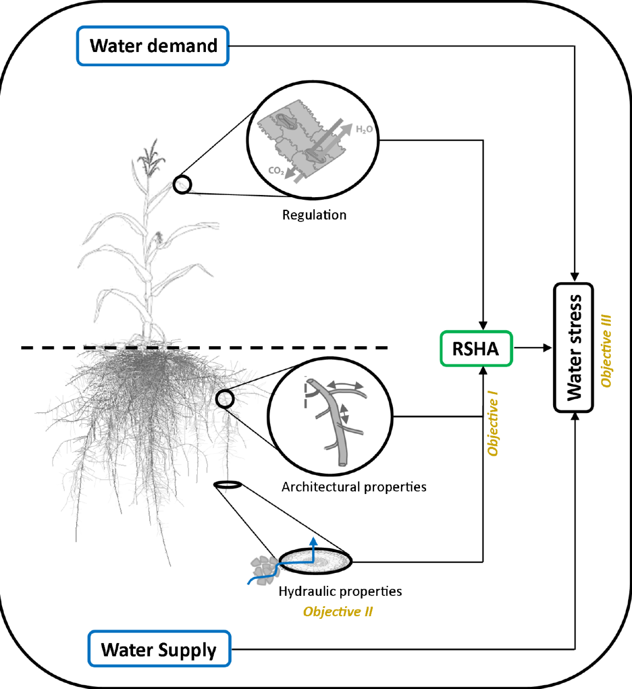
Introduction
Root functioning (water uptake and nutrient uptake) depends on the multiscale structure of the plant root system.
Cell tissues determine hydraulic properties of root segments, which may change over time due to aging.
At the larger scale of organisation, the amount of root segments and how they are connected define the root system architecture (RSA).

Slide 3
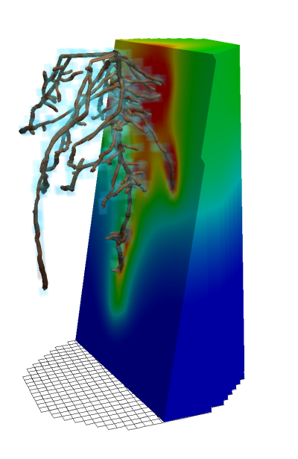
Introduction
Functional Structural Root Models (FSRM) represent the RSA and the hydraulic properties of root segments.
They describe water flow in the soil and root system starting from first principles.
They can be used to derive physically based root water uptake functions in larger scale land surface model.
But: Calibration and validation of FSRM is difficult. Root system is invisible and root properties are hard to measure.
Objective:
Use non-invasive imaging to visualize the root system in combination with flow and transport processes in the soil.
Derive from this information hydraulic root properties.

Slide 4
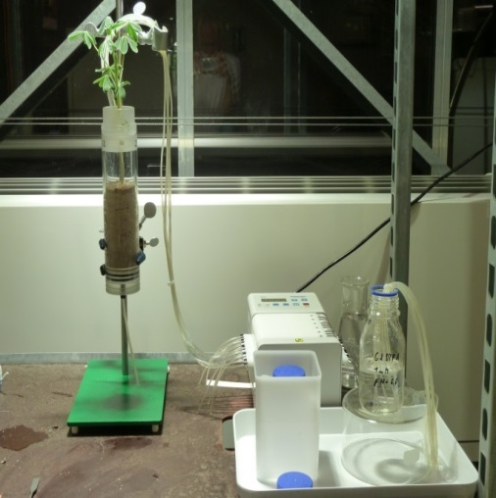
Tracer experiment
Calibration period
irrigation
transpiration
drainage

Slide 5
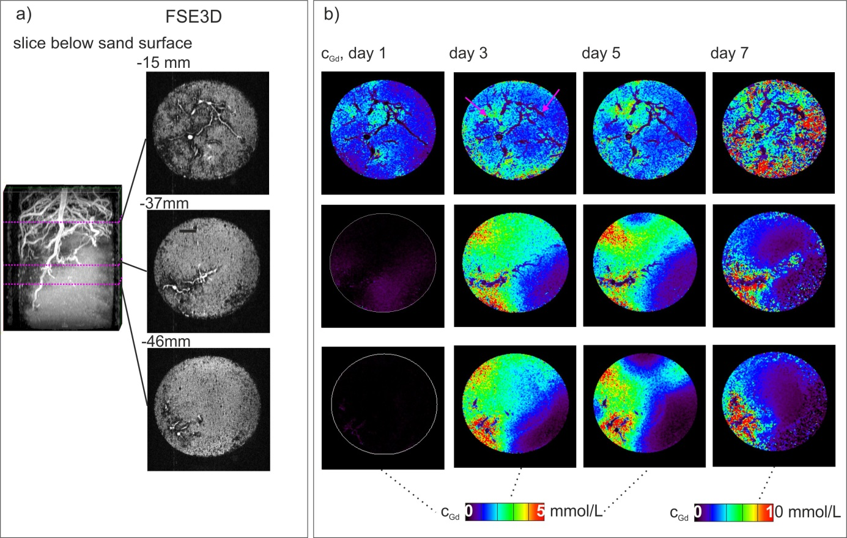
Using MRI for functional structural root monitoring
Mapping tracer (GdDTPA) distribution in the root zone
Monitoring root growth
Haber-Pohlmeier et al., 2017, WRR

Slide 6
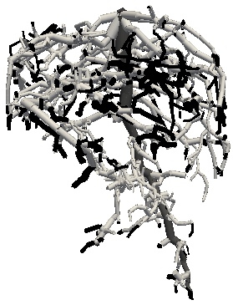



Simulation setup
Root system with 3 different root types depending on age
Water flow in soil-root –> R-SWMS
Tracer transport in soil –> PARTRACE (no uptake by the plant roots of GdDTPA)
Boundary conditions:
Root collar: flux boundary from transpiration
Top soil surface: flux boundary from irrigation
Bottom boundary: constant pressure? (Need to ask Axelle)
Taproot (T)
Lateral roots < 5 days-old (L_{y})
Lateral roots > 5 days-old (L_{o})

Slide 7
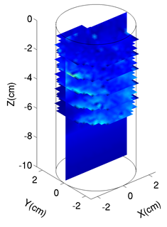
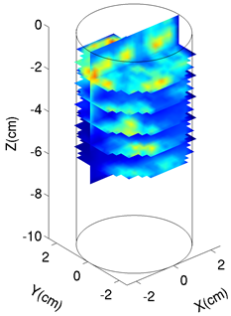
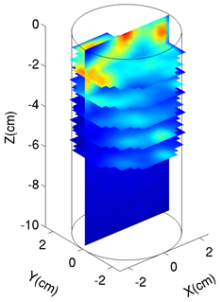

Calibration of root parameters
Comparison between measured and simulated GdDTPA concentrations at the end of the experiment when irrigation was stopped and water flow and tracer transport were mainly determined by root water uptake.
MRI Day 5
MRI Day 7
R-SWMS Day 7
[Gd-DTPA²⁻] (mmol L⁻¹)
15
10
5
Koch et al., 2019, JExpBot
0

Slide 8
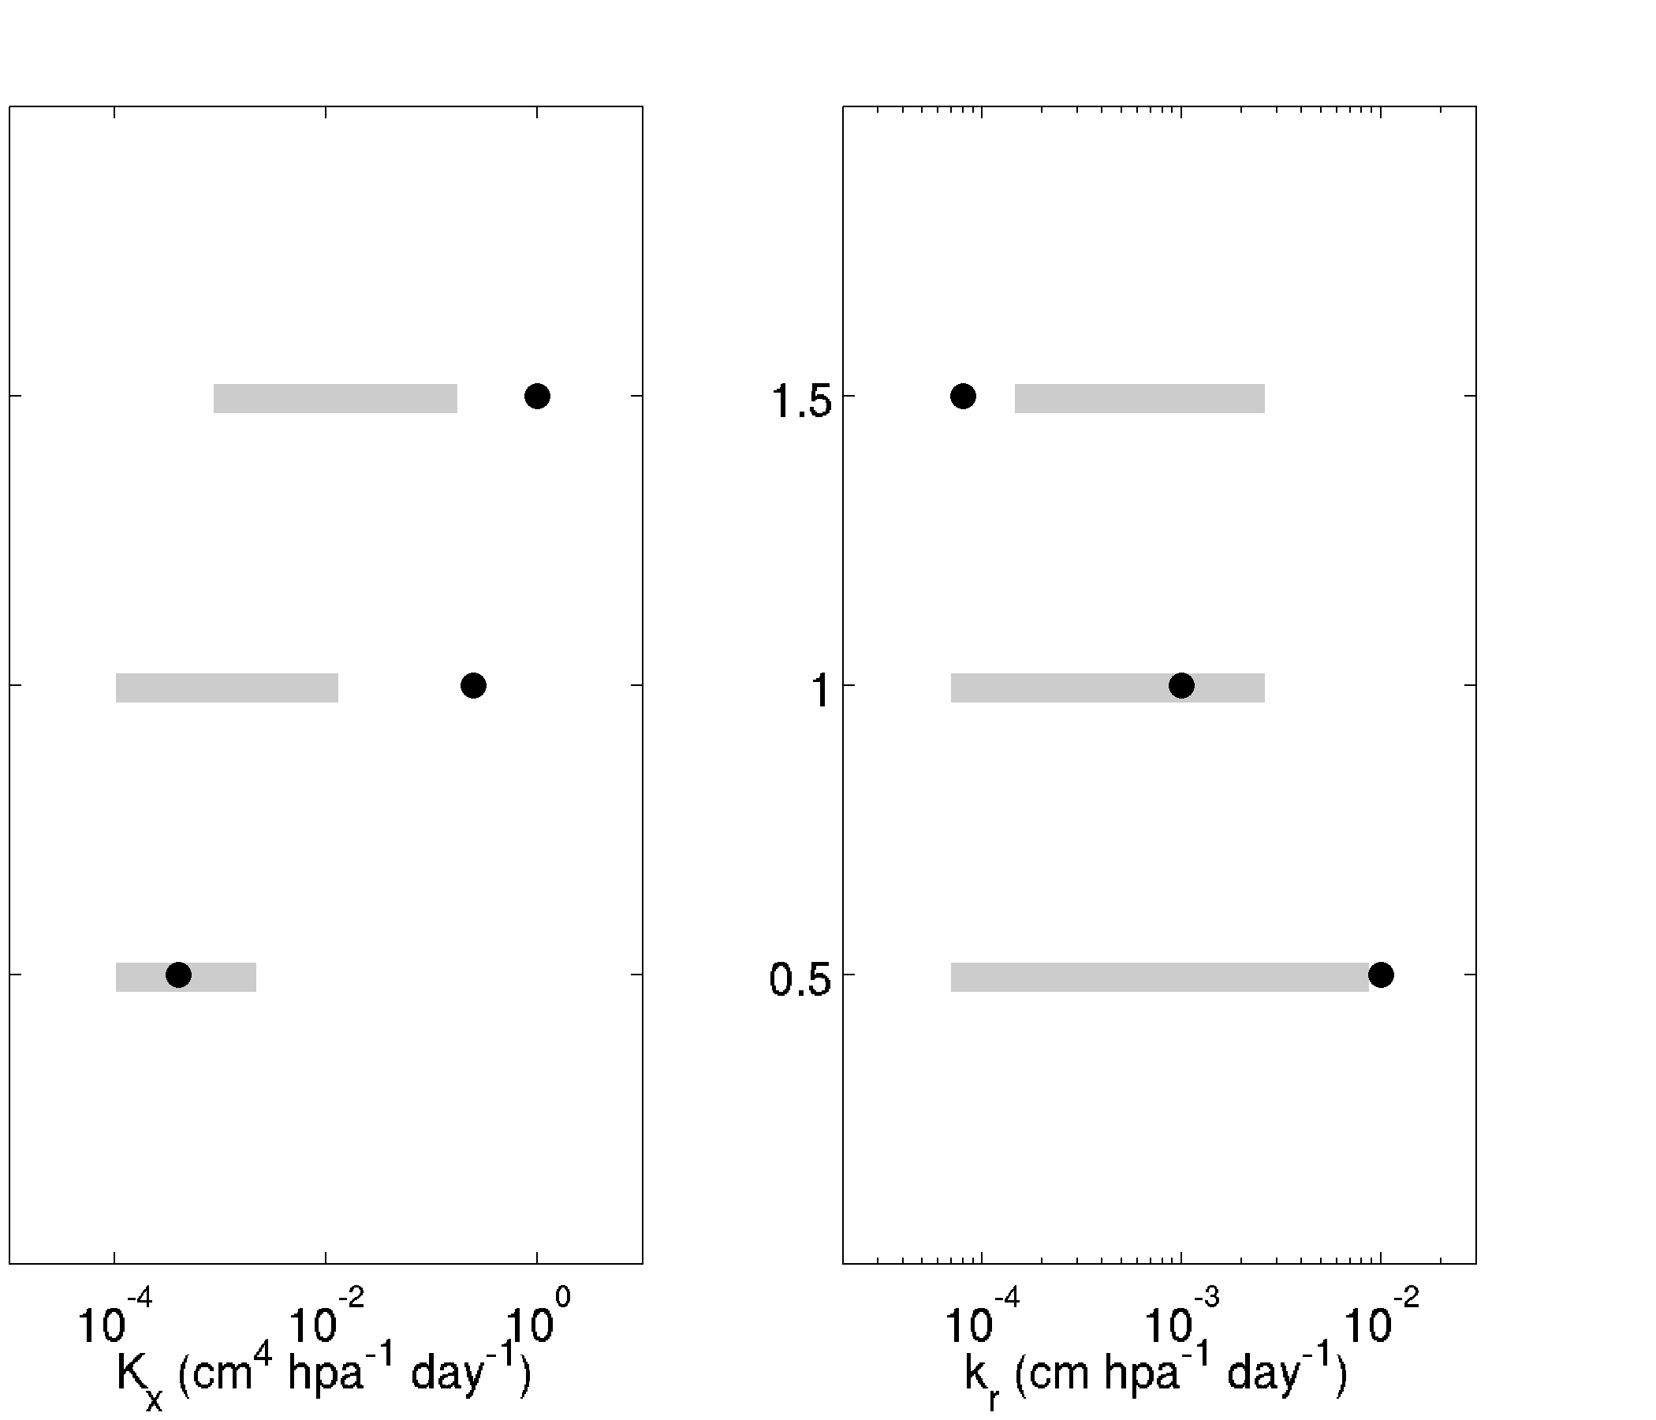
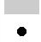
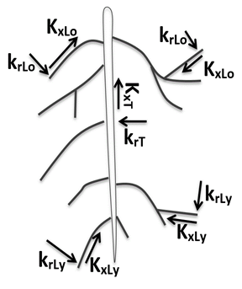
Calibrated parameters
Literature ranges
This work
K_{xT}
k_{rT}
K_{xLo}
k_{rLo}
K_{xLy}
k_{rLy}

Slide 9
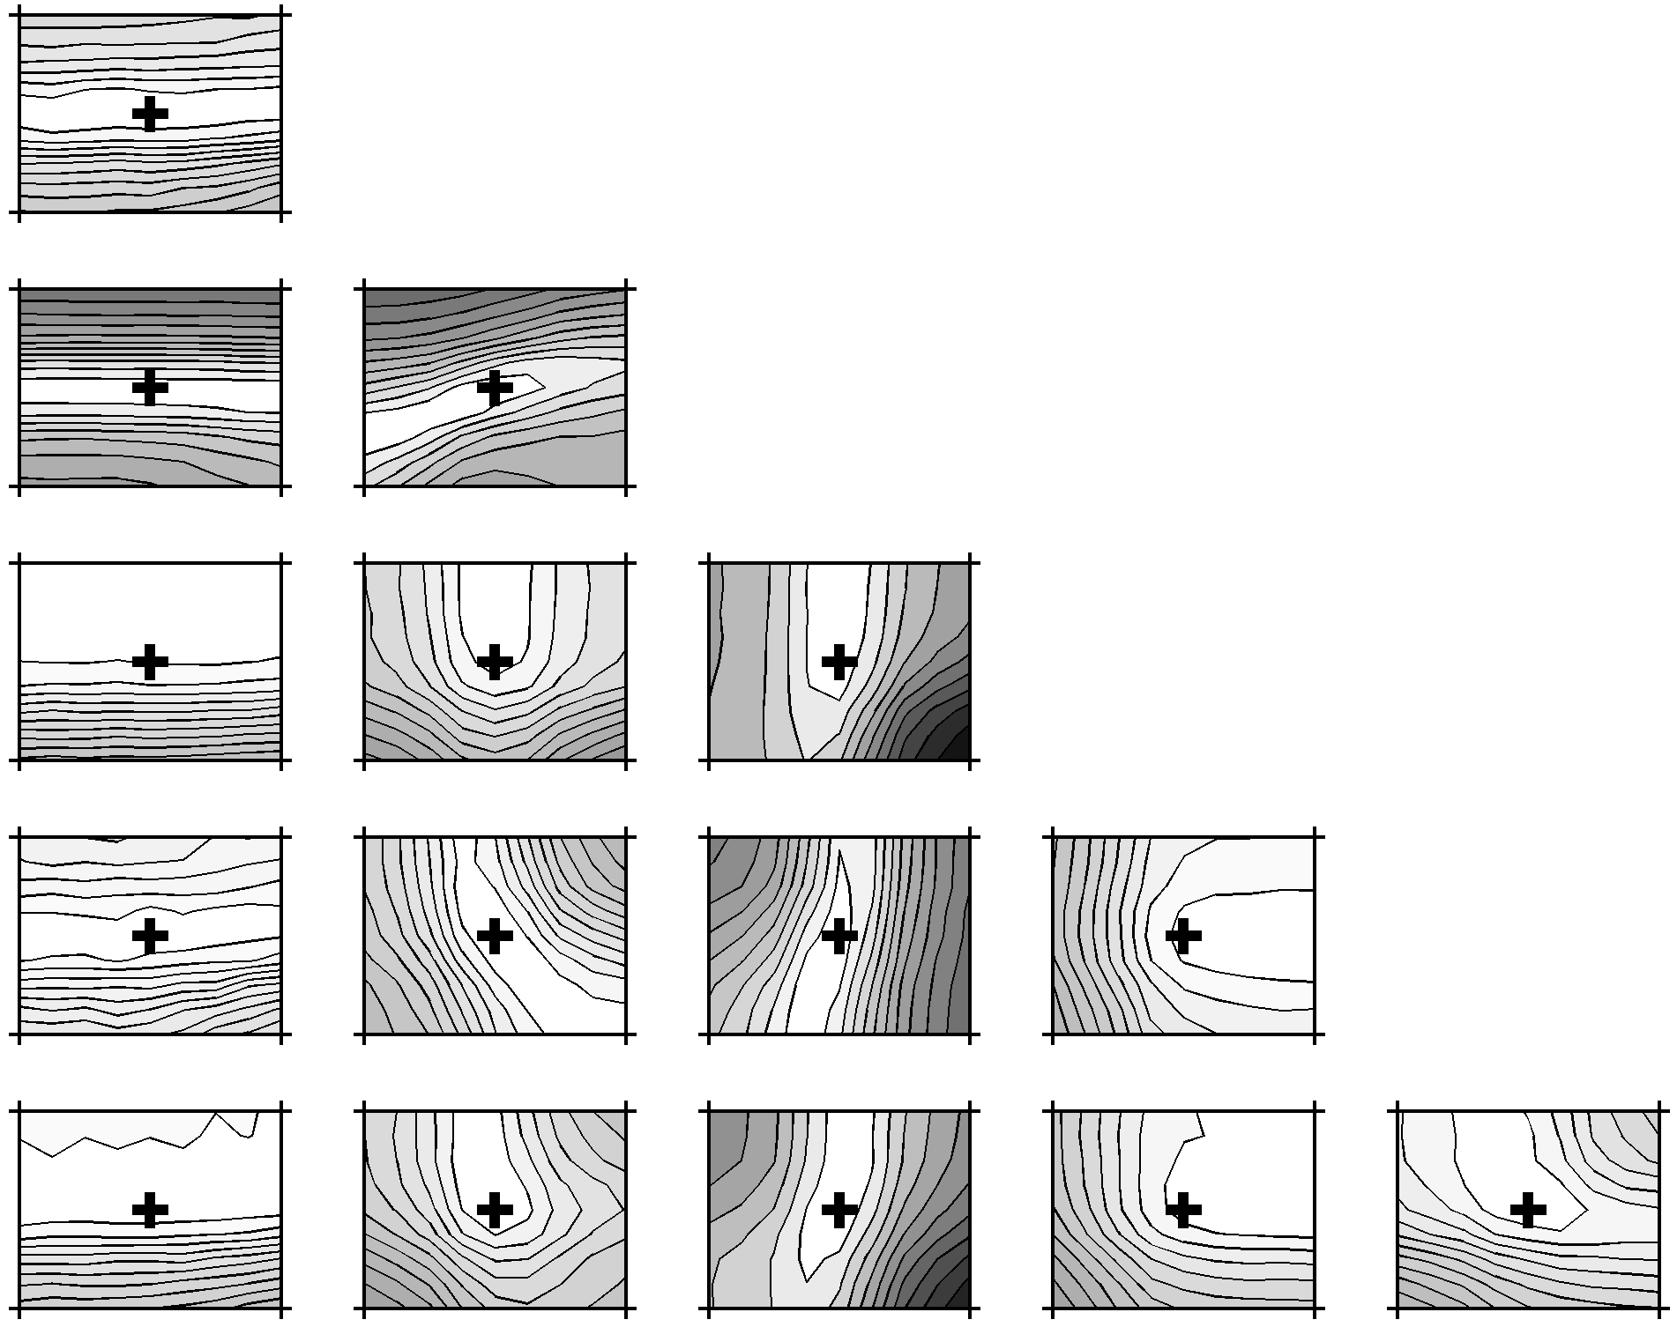
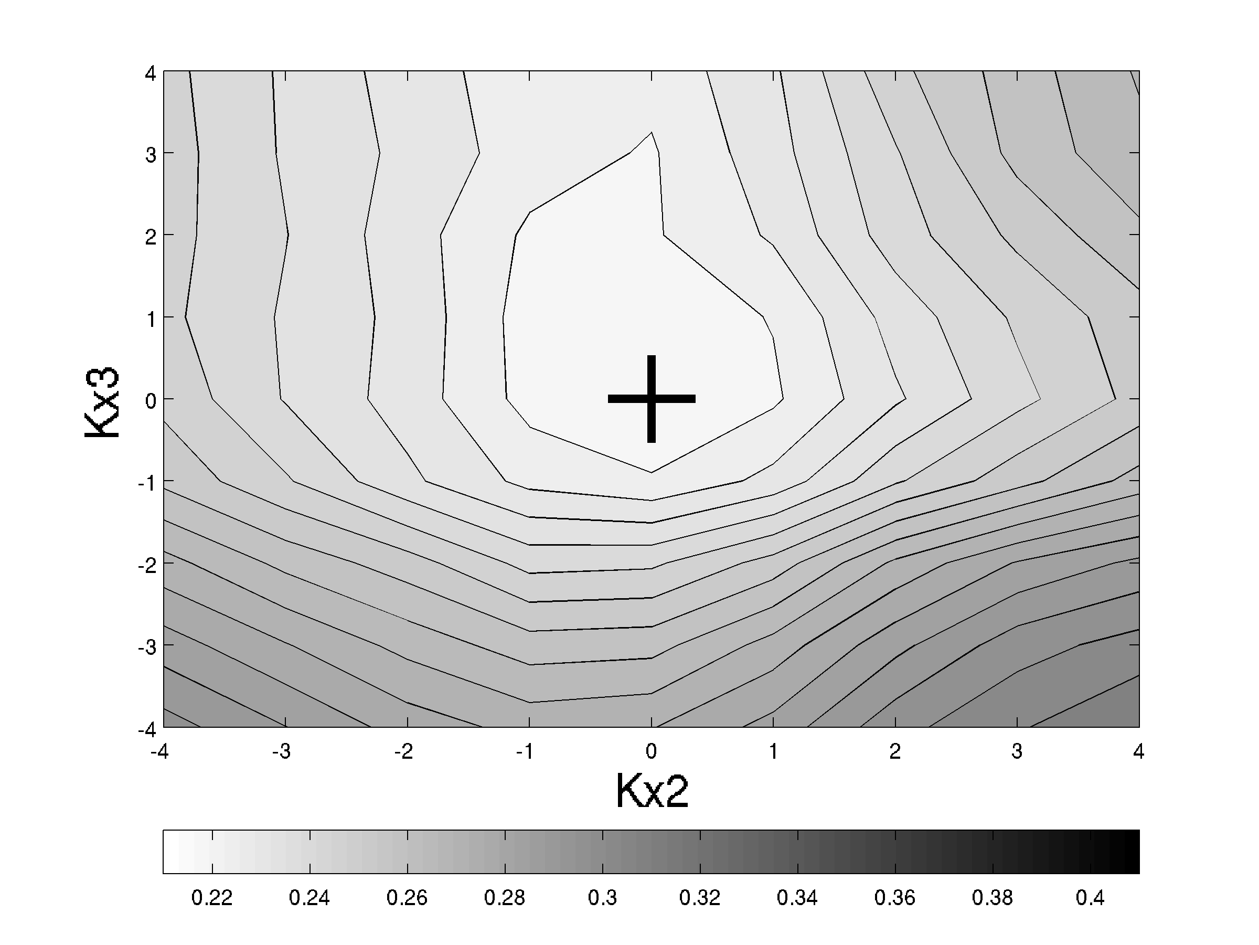
K_{xLo} K_{xLy} K_{xT} k_{rLo} k_{rLy} k_{rT}
k_{rT}=8*10⁻⁵
cm hPa⁻¹ day ⁻¹
RMSE
8*10⁻²
k_{rLy}=10⁻²
cm hPa⁻¹ day ⁻¹
0.25
0.6
1.25*10⁻³
8*10⁻³
k_{rLo}=10⁻³
cm hPa⁻¹ day ⁻¹
1.25*10⁻⁴
8
K_{xT}=1
cm⁴ hPa⁻¹ day ⁻¹
1.25*10⁻¹
3.2*10⁻³
K_{xLy}=4*10⁻⁴
cm⁴ hPa⁻¹ day ⁻¹
5*10⁻⁵
2
K_{xLo}=2.5*10⁻¹
cm⁴ hPa⁻¹ day ⁻¹
3.125*10⁻²
10⁻⁵
6.4*10⁻⁴
1.25*10⁻³
8*10⁻²
1.25*10⁻⁴
8*10⁻³
1.25*10⁻¹
8
5*10⁻⁵
3.2*10⁻³
k_{rT} k_{rLy} k_{rLo} K_{xT} K_{xLy} K_{xLo}

Slide 10
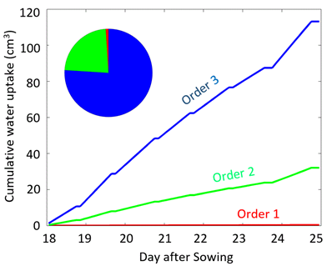
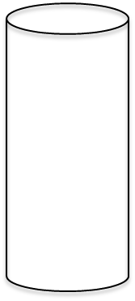
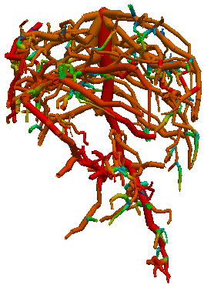
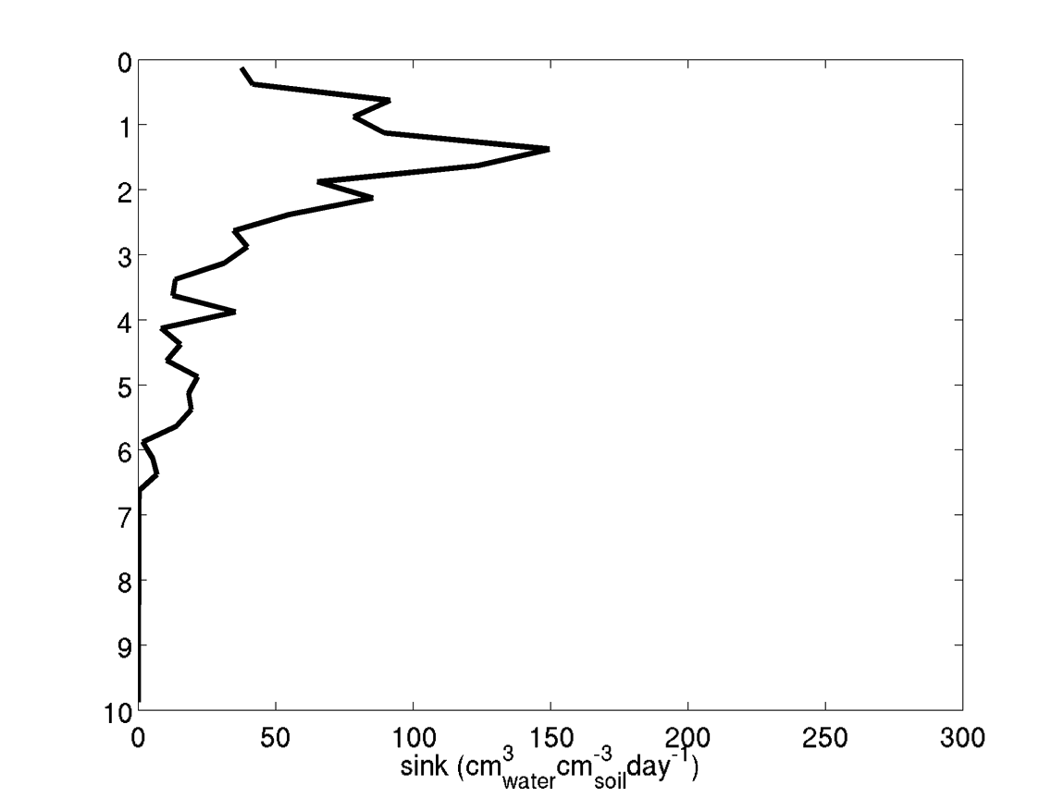
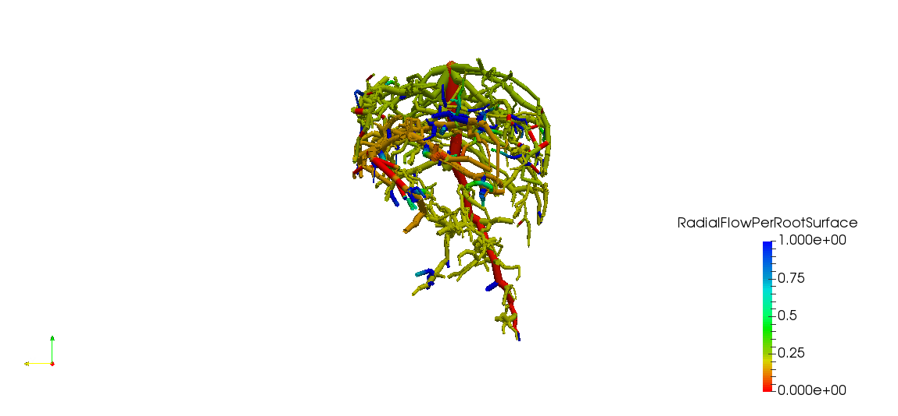
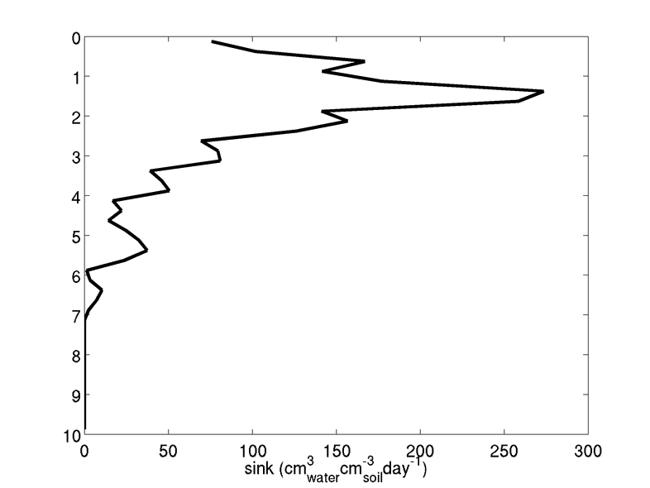

Application of the Model
Calibrated model is used to predict the contribution of different root order to water uptake
Cumulative water uptake (cm³)
DaS 19
DaS 25
Radial flow per root surface
(cm³ cm⁻² day⁻¹)
1
0.75
0.5
Day after Sowing
0.25
0
0.7
0
0
0.7
WUD (cm³ cm⁻³ day⁻¹)
WUD (cm³ cm⁻³ day⁻¹)

Slide 11
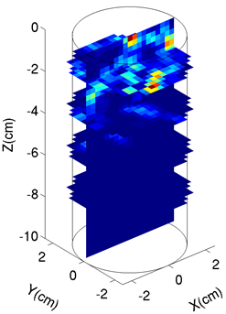
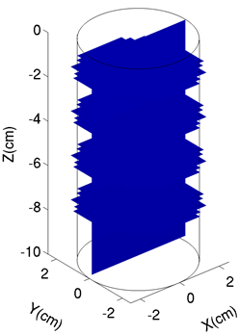
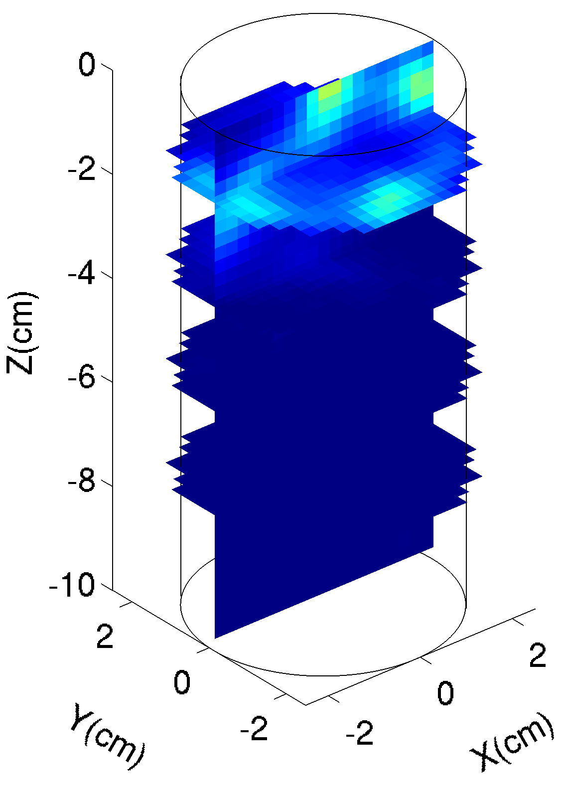

Application of the Model
Other proxies for root water uptake?
Can water depletion or local solute accumulation be used to estimate the distribution of the water uptake by the root system?
Cumulative WUD WD Acc.
Normalized variable (-)
x 10⁻³
2
1
0

Slide 12
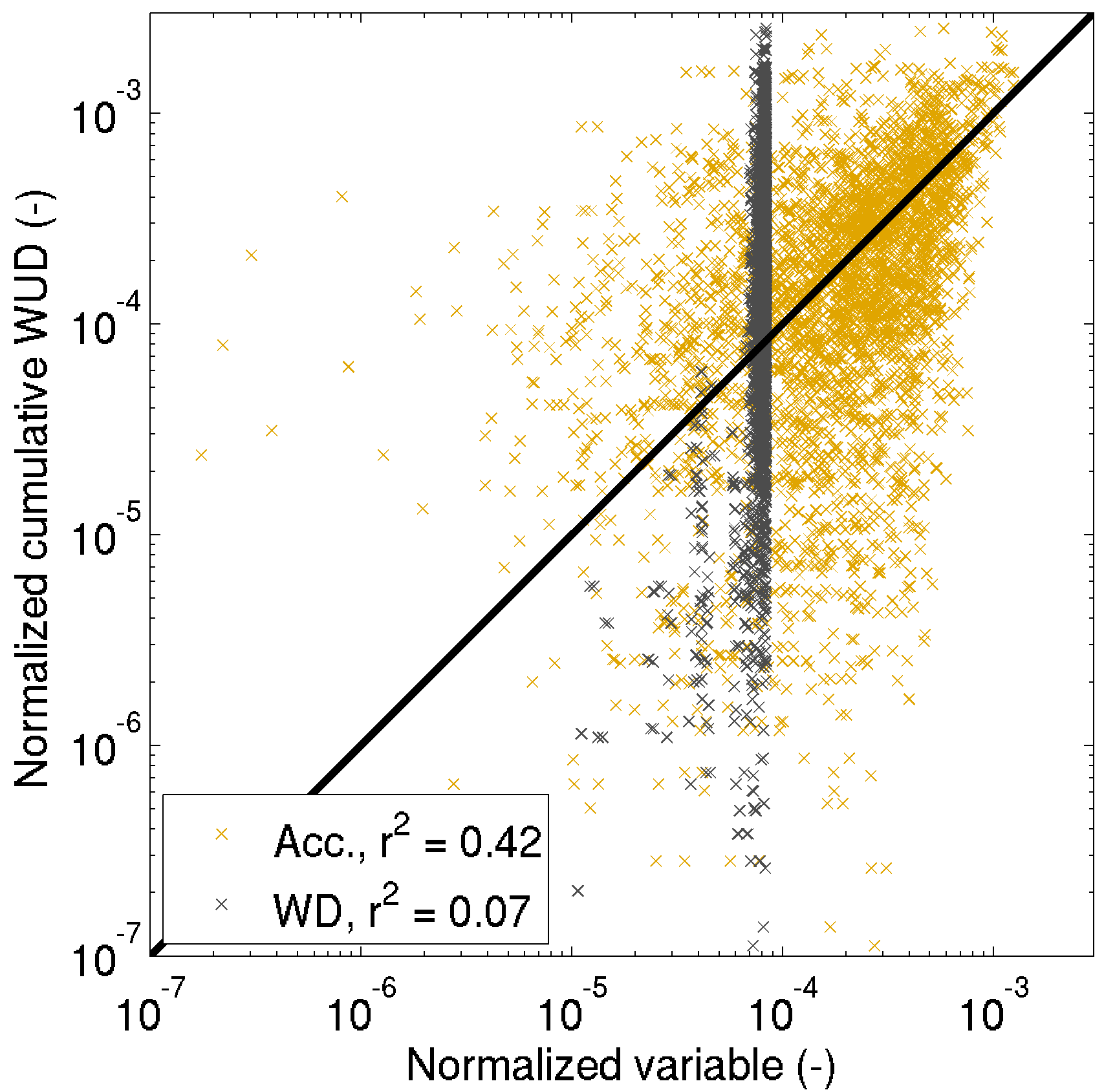
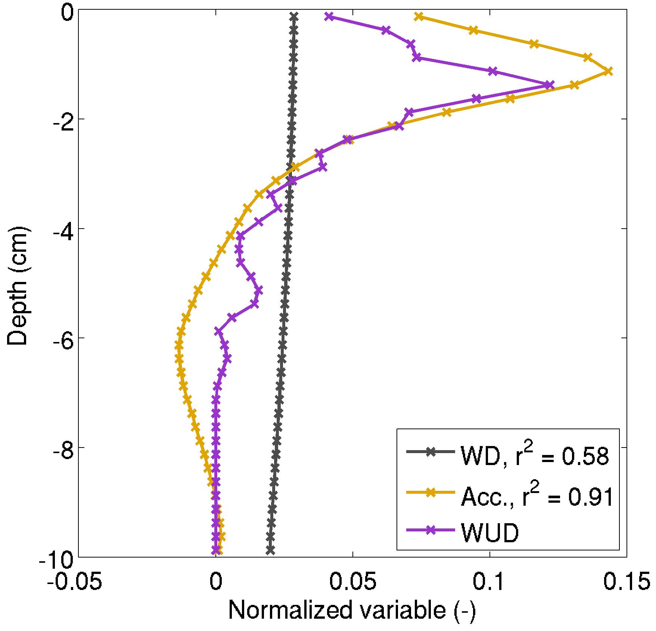
Application of the Model
The use of tracer acummulation as a proxy for root water uptake improves when the water uptake process is averaged over a larger scale.
3D
1D)
1:1 line

Slide 13
Conclusions: Validation or Calibration?
When root hydraulic properties are not known, a strict validation is not possible.
But, the retrieved root hydraulic parameters are consistent with what is expected based on the anatomy of roots: larger radial conductance of younger roots, larger axial conductance of older roots.
The sensitivity analyses showed that the parameters were constraint by the tracer data.
The (calibrated) model reproduces the tracer accumulation in the soil column well, which indicates that the distribution and strenght of the water uptake is well reproduced.
This gives confidence in the water uptake estimates by the different root segments.
Information obtained from functional-structural imaging of root zone processes can be interpreted more accurately using functional-structural soil-root models.

Slide 14
Thank You
References:
A. Koch, F. Meunier, M. Javaux, A. Pohlmeier, J. Vanderborght and S. Garré. Functional-structural root system model validation using soil MRI and tracer experiment. Journal of Experimental Botany,doi:10.1093/jxb/erz060(2019).
S. Haber-Pohlmeier, J. Vanderborght and A. Pohlmeier. Quantitative mapping of solute accumulation in a soil-root system by magnetic resonance imaging. Water Resources Research, 53,(8),doi:10.1002/2017wr020832, 7469-7480, (2017).

